Slide 1




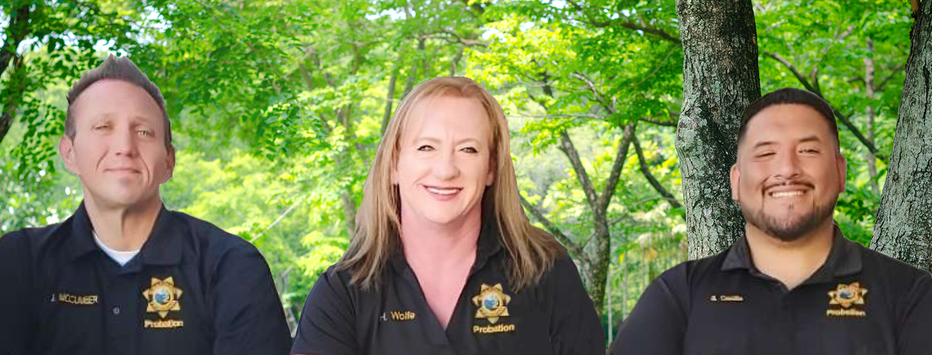
2024-2025
PROBATION AND SCHOOL SUCCESS PROGRAM

Slide 2
THANK YOU TO OUR DEPARTMENT FOR THE CONTINUED SUPPORT OF THE P.A.S.S. PROGRAM
Chief Probation Officer
Matt Ricardy
Martha Hernandez
James Moralez
Laura Topete
Paula Gomes
Deputy Chief Probation Officer
Deputy Chief Probation Officer
Juvenile Program Manager
Supervising Deputy Probation Officer

Slide 3

YUBA COUNTY PROBATION DEPARTMENT
In Partnership with:
Wheatland Union High School
&
Yuba County Office of Education

Slide 4
TABLE
OF CONTENTS
INTRODUCTION to P.A.S.S. PROGRAM
Yuba County Probation Mission Statement Juvenile Division
Wheatland Union High School District Vision Statement
Yuba County Office Of Education Mission Statement
Yuba County Probation/Victim Services
Truancy Prevention Program
Wheatland union high school district
Wheatland Union High School
Yuba county office of education
Thomas E. Mathews Community School
APPENDIX
Welfare and Institutions Code
California Education Code
Juvenile Court Jurisdiction
Core Duties
P.A.S.S. Officer Training Hours

Slide 5
INTRODUCTION
In 1990, the P.A.S.S. Program collaborated with the Yuba County Office of Education and placed a probation officer at Thomas E. Mathews Community School.
In 2022, Wheatland Union High School District collaborated with the P.A.S.S. Program to assign a probation officer at Wheatland Union High School. The primary goal of the program has been to counteract factors interfering with student learning and performance with a comprehensive and multifaceted approach, based on interventions facilitated by law enforcement personnel.
In 2023, the “South County School Attendance Review Board (SARB)” was created. The Yuba County Probation Truancy Program collaborated with our South County partners, to assist the Wheatland Elementary School District, Plumas Lake School District, and the Wheatland Union High School District.

Slide 6
This collaborative approach includes::
Facilitate student and family access to services and special assistance as needed.
Provide intervention to families and students in crisis situations.
Provide student and family support as student’s transition through grade level changes.
Increase the relationship and/or partnership between home and school.
Increase community involvement and support to enhance the use of volunteers at the school site.

Slide 7
This is a preventative program that focuses on the following:
To reduce violence at home and at the school site
Identify and provide intervention services relating to child abuse
Reduce the number of referrals to the criminal justice system using proactive measures
Provide a coordination of resources and behavioral strategies that foster resiliency

Slide 8
This proactive approach is the core of the program. The program incorporates high standards for learning, related to social and personal functioning.
Enhancing the student’s individual potential results in measurable outcomes that include:
  Increased academic performance
  Increased promotion rates
  Reduction of violence at the school sites
  Reduce out-of-school suspensions
  Increase family involvement
  Improved attendance among all students as truancy issues are proven to be a contributing factor in juvenile crime and delinquency

Slide 9
A large majority of our students are exposed to factors in their lives that sometimes create barriers to learning and must be addressed so students can excel in their education. This often becomes the focus for intervention.
The program stresses the importance of parental commitment in nurturing, supporting, and facilitating the desired change in their child. Parental involvement is imperative to a child’s success at school.
P.A.S.S. Officers are involved in fostering active parent participation. Parents often see our P.A.S.S Officers as allies rather than enforcers and are subsequently more apt to participate in much needed services and interventions.

Slide 10
P.A.S.S. Officers take responsibility for coordinating resources on a school-wide level to address the barriers to learning.
Analyzing existing resources and clarifying how they can be used even more efficiently and effectively is the goal of every officer.
By creating a caring and supportive climate within the face of law enforcement, school-wide changes have resulted that both minimize violence and enhance feelings of competence and connections among students.
This effort begins at the grade-school level and continues through high school, including all alternative education programs.
Programs at each site adapt to the diversity of that particular school environment.

Slide 11
The success of the P.A.S.S. Program can be directly related to the principles that generated its founding:
Implementation of a quality multi-agency program
Importance of community
Caring and knowledgeable adults
Provide social support and advocacy
Parent/guardian involvement
High standards and expectations
Continuum of lasting support services

Slide 12
At each school site, our officers assist in developing a school-wide atmosphere that encourages mutual support and a sense of community among students, parents and staff.
This collaboration between the Wheatland Union High School District and the Yuba County Office of Education has created a collective vision.
This vision ensures that everyone involved is a stakeholder in the betterment of our community and the students we serve.

Slide 13
All students involved in the P.A.S.S. Program are referred from some of the following sources:
  School Administration
  Parent/Guardian
  School Staff Members
  Teachers
  Outside agency
  Yuba County Probation Department
  Yuba County Juvenile Court

Slide 14
YUBA COUNTY PROBATION DEPARTMENT
MISSION STATEMENT:
The Yuba County Probation Department's mission is to promote the health and safety of the community through programs of prevention, intervention, treatment and detention services. These are accomplished by:
  Enhancing judicial decision making through assessment of offender risks and needs
  Enforcing court orders and sanctions
  Engaging in prevention, intervention, and treatment collaboratives
  Moving probationers to lawful self-sufficiency
  Supporting the rights of victims
“SUPPORTING POSITIVE CHANGE”

Slide 15
Yuba County Probation Department Values & Beliefs:
  We believe that people can change and that we can be instrumental in directing that change.
  We believe people should be responsible and held accountable for their behavior and decisions.
  We believe the family is the core social unit and should, wherever practical, be kept intact.
  We believe every person is entitled to be treated with dignity and respect.
  We believe in the restoration of the victims' dignity, health and resources.
  We value a diverse workforce, reflective of the community we serve, and able to respond to their individual needs and circumstances.
  We believe the most valuable asset of our Department is its employees.

Slide 16

Wheatland Union High School District
We are committed to our vision of setting high standards for both students and staff, using a collaborative system of support ensuring every student can attain academic excellence. We have established firm goals that build the foundation of success for our students:
GOAL 1 - Wheatland Union High School District students will graduate high school college and career ready.
GOAL 2 - Wheatland Union High School District students will feel a sense of connectedness academically, socially, emotionally, and physically in their schools.
GOAL 3 - Wheatland Union High School District will engage families and members of the greater school community as educational partners.

Slide 17
SUPERINTENDENT
W.U.H.S.D. Board of Trustees
Nicole Newman- Superintendent
Kerri Hubbard- Chief Business Officer
Tony Lopez President
Ryan Belflower Clerk
Greg Forest Member
Peter Gryn Member
Zach Zapata Member
Liliana Saldana Student Board Member
What it Takes to Lead…

Slide 18

Mission Statement
Bridging the gap between education and career opportunities, fostering collaboration between schools, businesses, and community to empower individuals with skills and resources needed for a better future.

Slide 19

Motto:
Better Together
Vision:
Leading our students and community to a better future.

Slide 20

Core Values and Cultural Norms:
Core Values:
  Student & Family Focused
  Service Oriented
  Value YCOE Staff as Family
  Cultivate Leadership
  Fiscal Sustainability
  Cultural Norms:
  Professionalism
  Respect
  Integrity
  Develop Relationships
  Excellence

Slide 21
Superintendent of Schools
Rob Gregor- Superintendent
Halee Pomeroy-Executive Assistant to Superintendent
Amy Nore-Community Engagement & Emergency Response Administrator

Slide 22

Y.C.O.E Board of Education
Katherine Rosser
Trustee Area 1
John Nicoletti, Board President
Trustee Area 2
Marjorie Renicker
Trustee Area 3,
Desiree Hastey
Trustee Area 4
Tracy Bishop, Vice President
Trustee Area 5

Slide 23


Yuba county victim services
Yuba County Probation Department Victim Services Unit provides comprehensive support, advocacy, counseling, and treatment services to victims of crime. All treatment services are provided for those in need by county-based therapists and counselors.
Yuba County Victim Services also provides:
  Court Support Services
  Assistance in filing for Victims Compensation Claims
  Sexual assault - 24/7 response team
  Restraining orders with police reports
  Forensic Interviews through the Multidisciplinary child interview center
  Guidance through the criminal justice system
  Resource and referral to local community agencies
  Parent Child Interaction Therapy (P.C.I.T.)
  Therapy for Victims of Crime
  Assistance with Property Return
  Restitution Assistance
  Victim Information Notification Service

Slide 24
Truancy Program
Juvenile Probation Program Manager – Laura Topete
Supervising Deputy Probation Officer – Paula Gomes
Plumas Lake Director of Student Services – Jason Hofhenke
WUHS Executive Director of Student Services – Lauren Link
Yuba County Probation Truancy Officer – Heather Wolfe
SOUTH YUBA PREVENTION
2024-2025

Slide 25




The Yuba County Probation Department partnered with three School Districts in order to provide an outstanding truancy intervention program to keep students in school in the South Yuba County Districts:
The Wheatland Elementary School District, Plumas Lake Elementary School District, and the Wheatland Union High School District.
Statistics show that chronic truancy has devastating effects on both the student, their families, and the community. The short-term effects often result with an increase in delinquent, criminal, and gang activity. The long-term effects generally include poor mental health and a high risk of addiction and incarceration. Our truancy program provides early intervention to the many issues faced by students that frequently miss school. With early intervention and dedicated multi-agency commitment, we hope to re-direct the students who are possibly on their path to becoming juvenile offenders and/or dropouts. The truancy officer provides essential services to the school districts, probation department, students, and their families. With early intervention, our intent is to prevent at-risk youth from becoming part of the criminal justice system.
Agencies

Slide 26
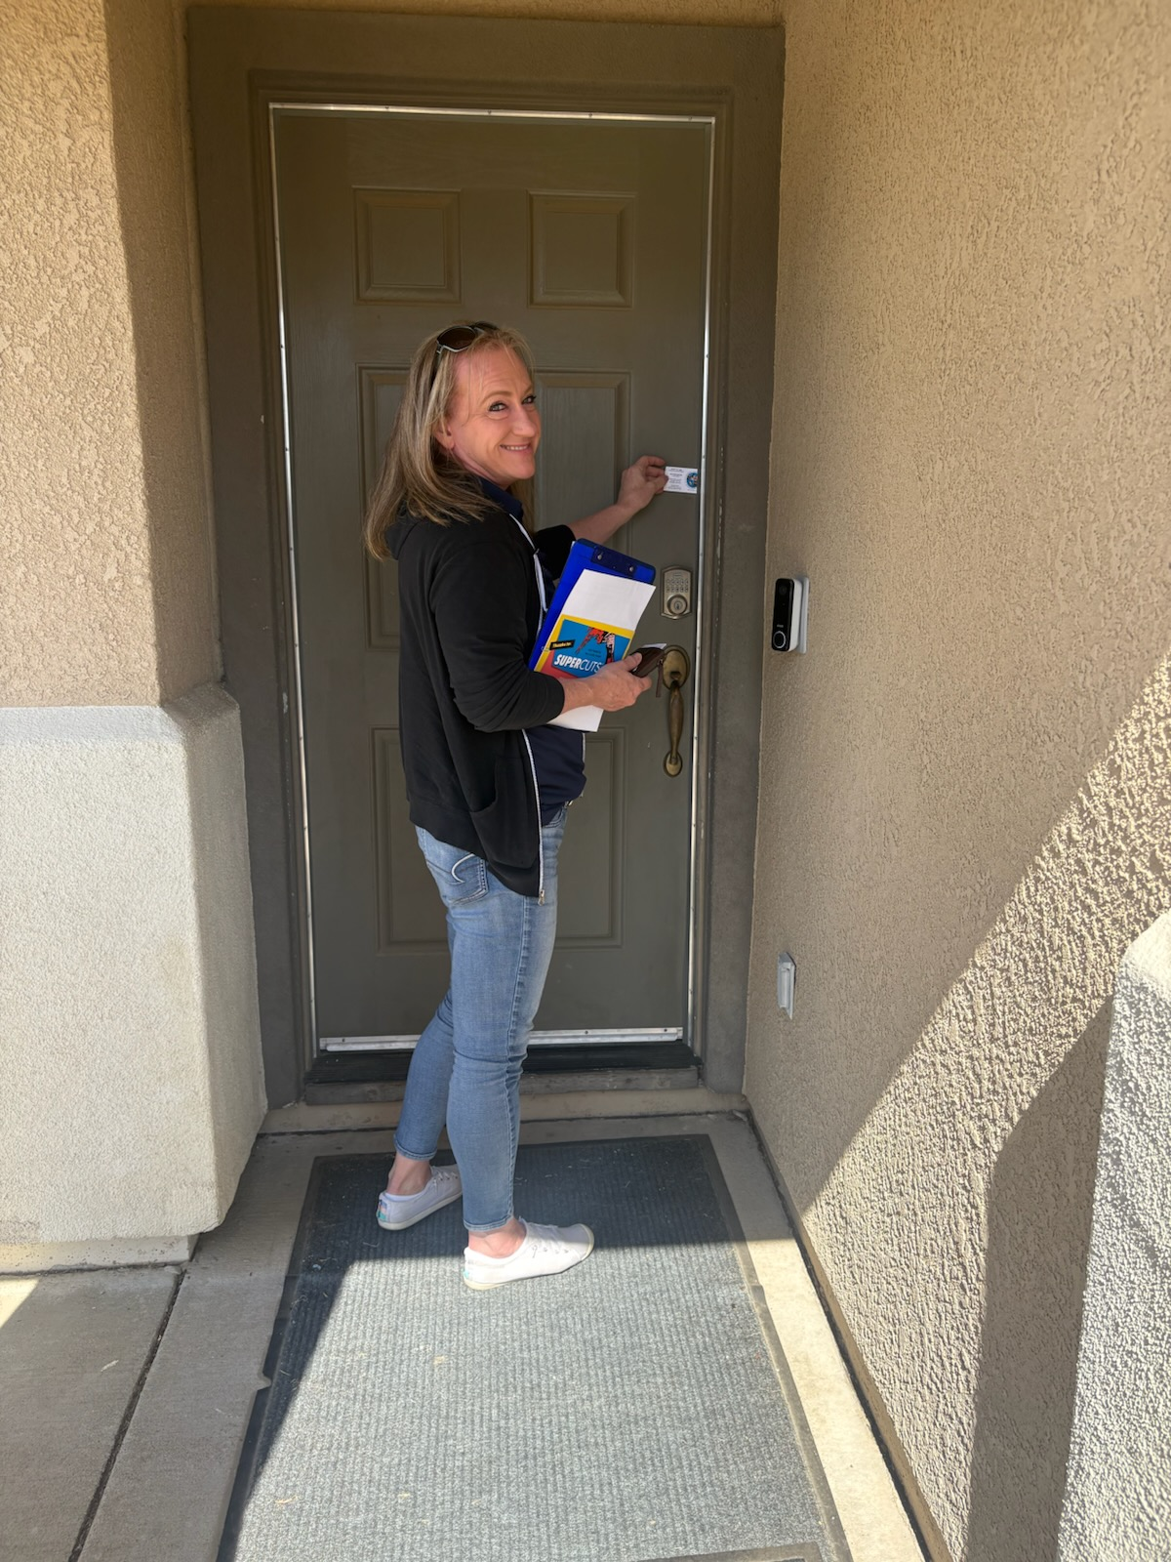
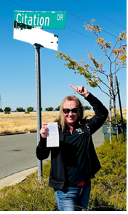
Truancy Officer Services
• Home visits and family intervention services.
• Referrals to social services; Child and Adult Protective Services, Victim Services, and other service-related agencies in the Yuba and Sutter counties.
• A member of the Displaced Youth Multi-Disciplinary Team.
• Manages the juvenile counsel and release caseload.
• Acts as the liaison between school and the law enforcement community.
• Assist all P.A.S.S. officers at the school site in truancy, recovery, and attendance-related issues.
• Assist the high schools at student breaks and lunchtimes as needed.
• Serve juvenile citations, subpoenas, and infraction complaints (violation of S.A.R.B. contract).
• Recovery of all students not enrolled in any school or educational programs within Yuba County.
• Locate W.U.H.S.D. and Alternative Education enrollment, attendance, grades and discipline on all juveniles pending Court proceedings to assist the juvenile court officers.
• Home visits as requested from school site personnel or follow-up on active cases.
• Transportation of the student to the school site of attendance.
• School visits to award improved students with improvement certificates.
• Participate in weekly Gang Meetings with school administrators, law enforcement officers, and probation
• Participate in Attendance Collaborative Meetings
Home Visits
photo title

Slide 27
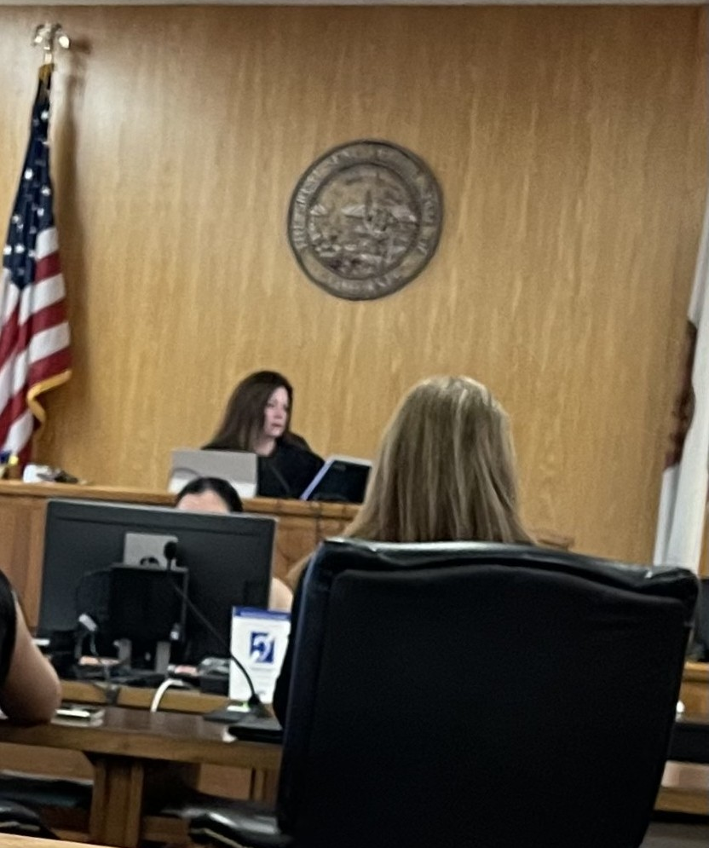
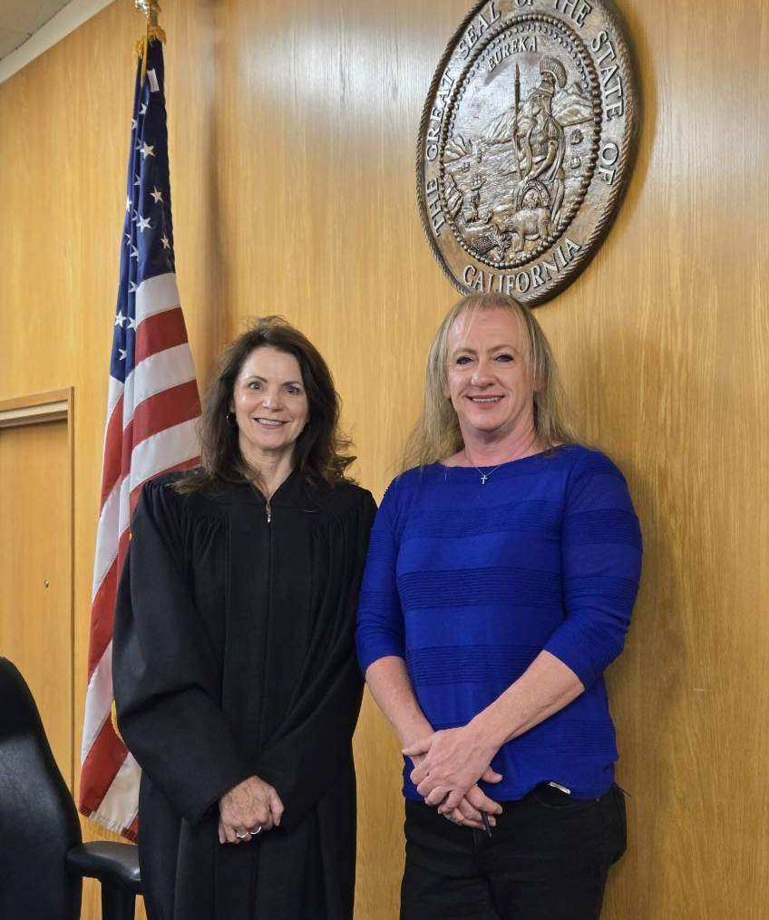
The Court
Through the commitment and cooperation of the Yuba County Superior Court, the SARB process moves forward with the most significant cases. There are currently 37 active South SARB cases. Of those active cases only ONE needed the intervention of the Court.
The Honorable Debra L. Givens, Presiding Judge of the Yuba County Superior Court, provides ongoing support by court-ordering families into counseling, parenting classes, and mental health support. Parents are admonished and strongly encouraged to participate in services. Judge Givens continues many of the cases in order to eliminate re-serving families multiple times. Families return to court multiple times until they have complied with Orders.
Every small improvement the family makes is rewarded. In court, the parents are praised for their efforts to keep their student in school. Certificates, signed by Judge Givens are given to all children with perfect attendance.
SARB COURT
Honorable Judge Givens & Truant Officer Heather Wolfe

Slide 28
STATS
YEAR | TOTAL SARB CASES | JUVENILE CITATIONS | INFRACTION COMPLAINTS | COURT CASES | FINES IMPOSED | ATTENDANCE AWARDS
2024-2025 | 37 | 37 | 1 | 2 | 0 | 12
2023-2024 | 16 | 16 | 1 | 1 | 0 | 8
This year, there was ONE SARB Case DISMISSED by the court.
SOUTH SARB

Slide 29
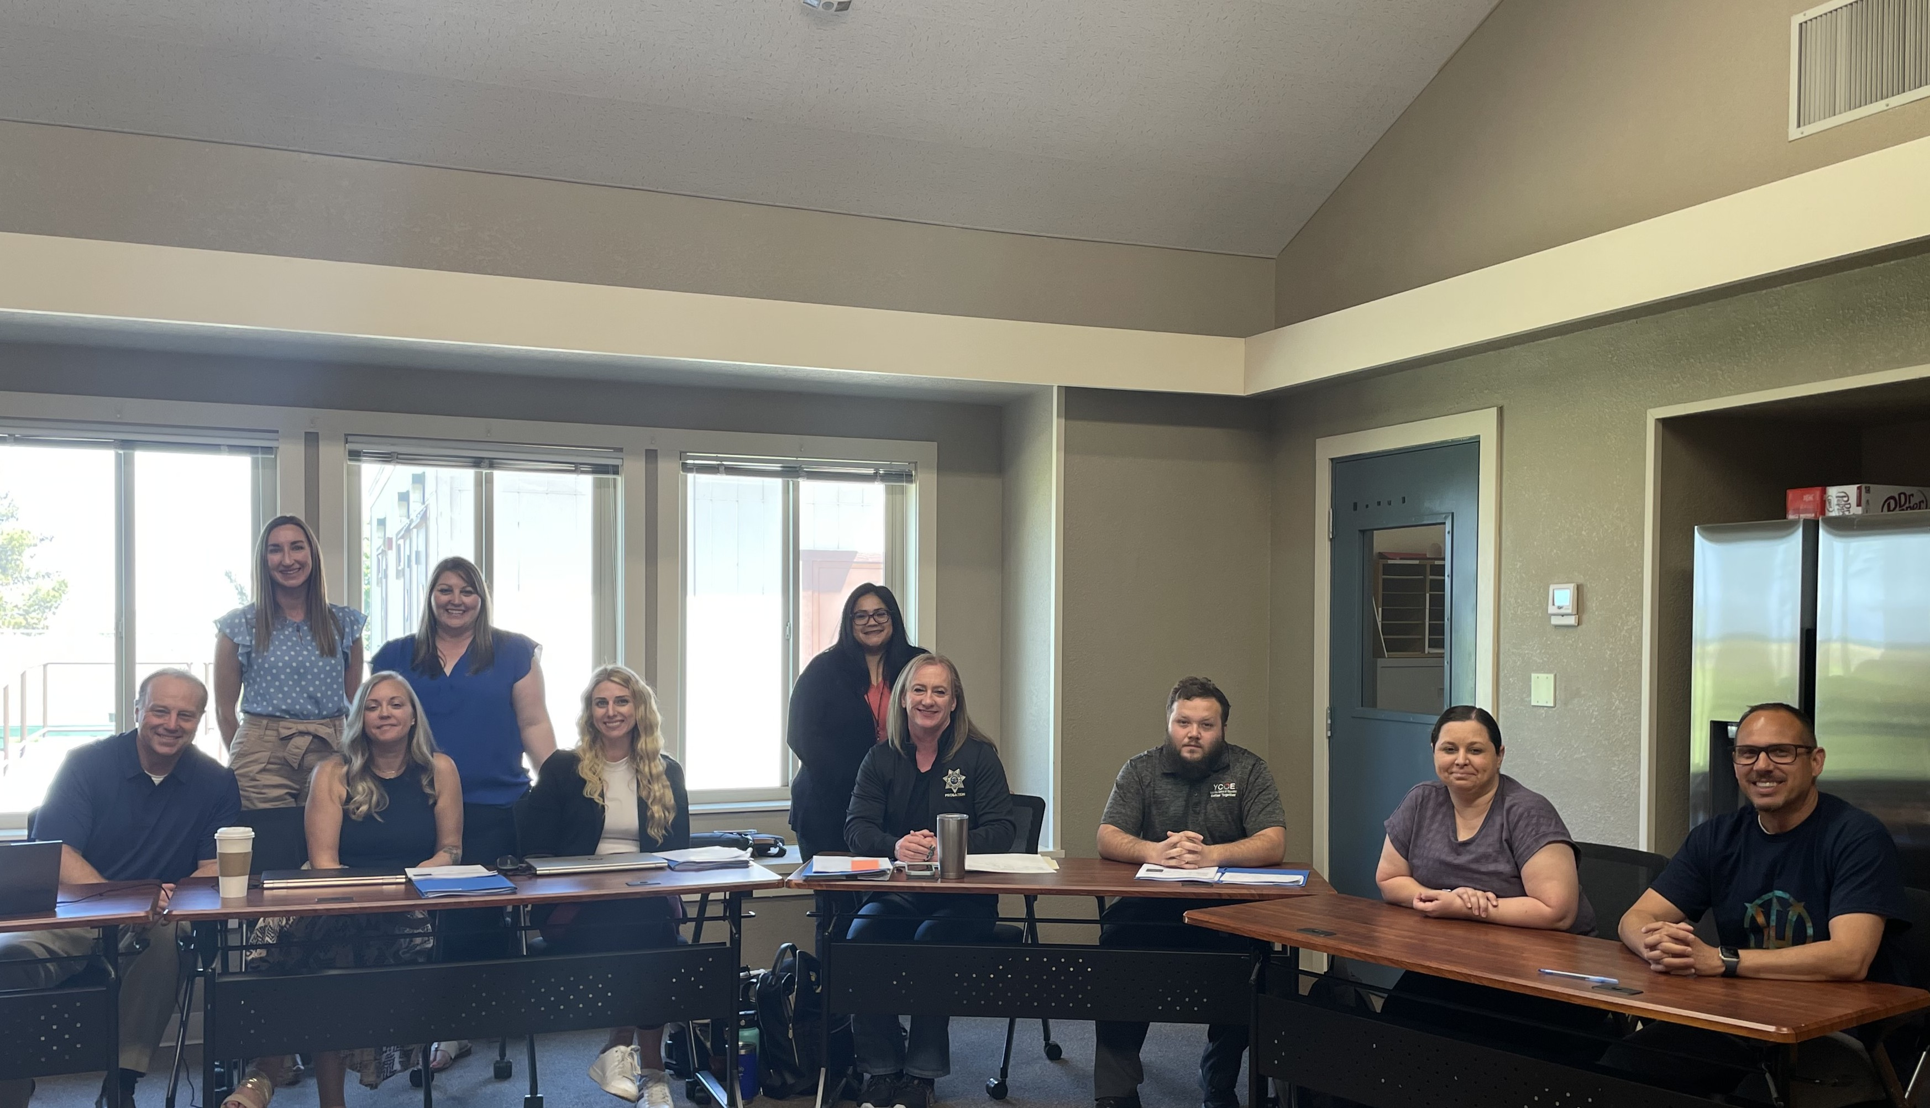


South County SARB Board
•Plumas Lake School District
•Wheatland School District
•Wheatland Union High School District
Board Members:
•Yuba County Probation Department
•Yuba County Health & Human Services
•Yuba County Office of Education

Slide 30
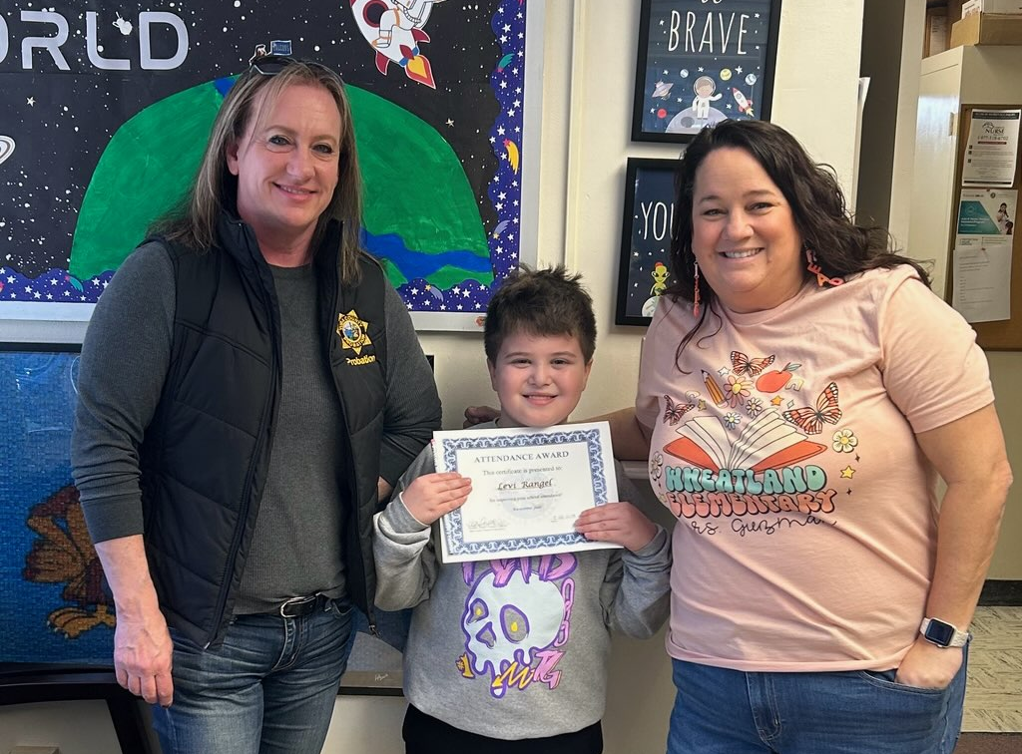
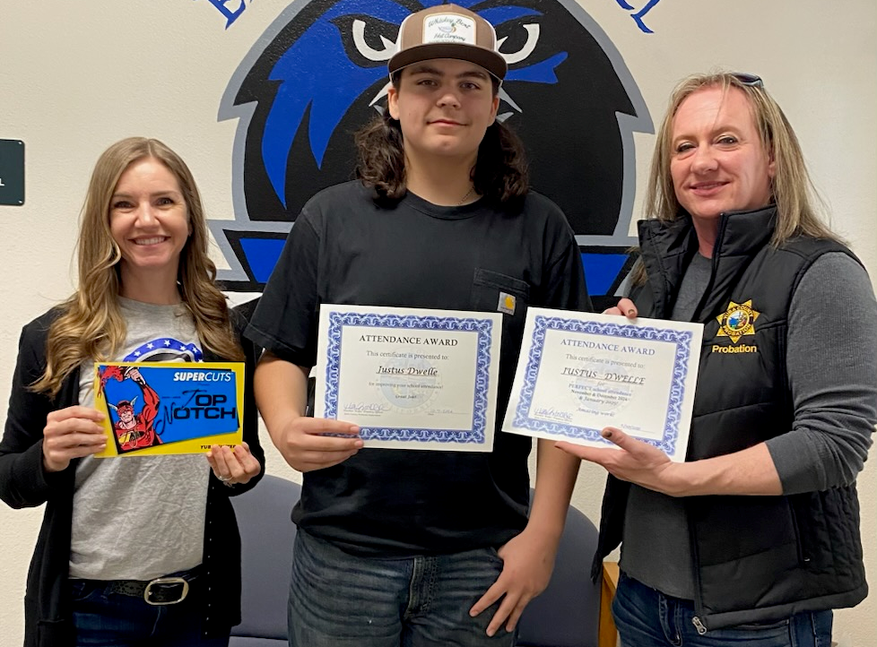
Wheatland School District Improved Attendance Awards
Way to go Levi!!
Great job Justus!

Slide 31

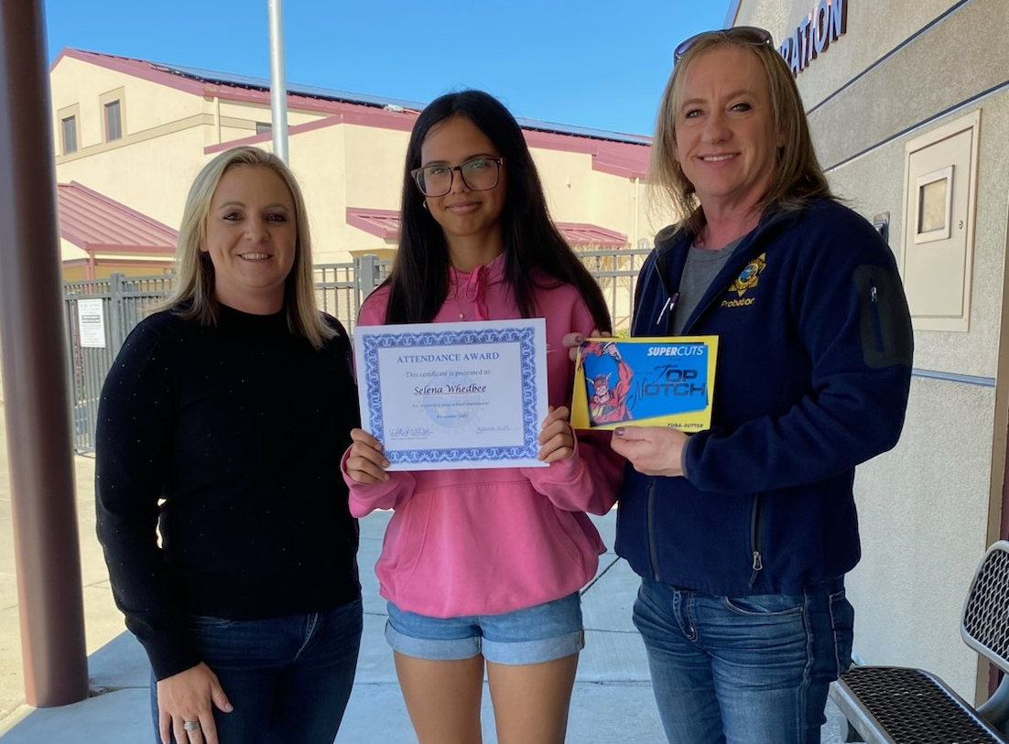
Plumas Lake Improved Attendance Awards
Proud of you both!
Great Job Selena!

Slide 32
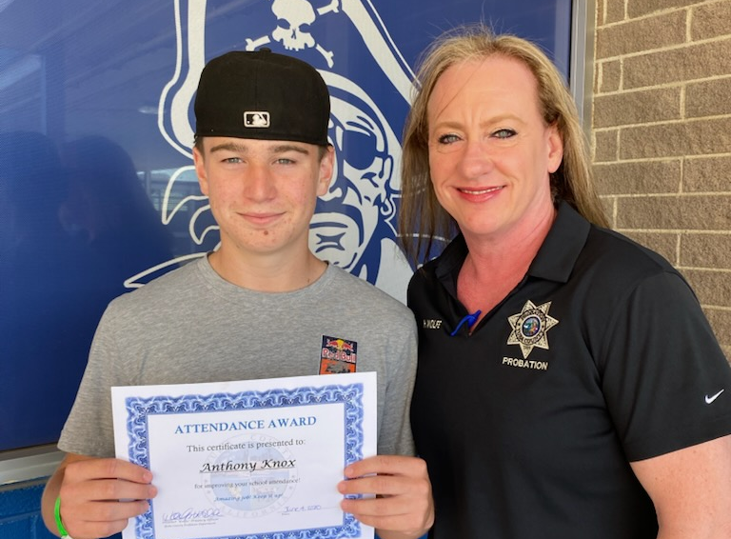
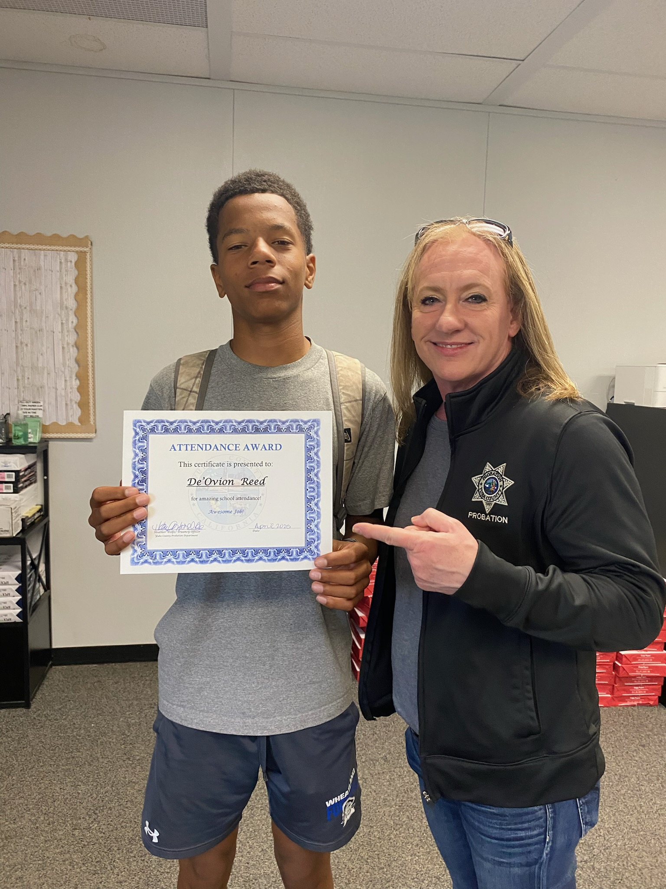
WUHS Improved Attendance Awards
Good job Anthony!
Perfect Attendance!

Slide 33


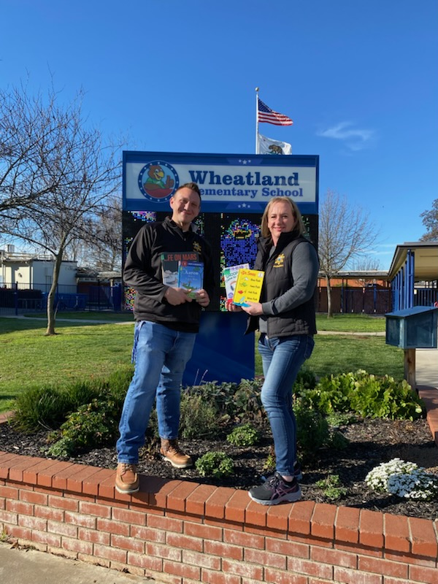

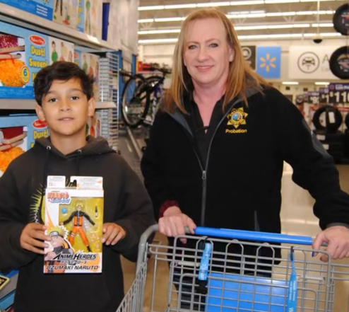



Making a difference in the community
READ ACROSS AMERICA for Dr. Suess Birthday at Wheatland Elementary School.
Shop with cop
WSD kindergarteners

Slide 34
If a child misses…. | That equals.... | Which is.... | And over 13 years of schooling that’s.…
1 day every 2 weeks | 20 days per year | 4 weeks per year | Nearly 1 ½ years of school
1 day per week | 40 days per year | 8 weeks per year | Over 2 ½ years of school
2 days per week | 80 days per year | 16 weeks per year | Over 5 years of school
3 days per week | 120 days per year | 24 weeks per year | Nearly 8 years of school
Attendance Matters
Missing 1 or 2 days may not seem like much, but…the days add up quickly!

Slide 35
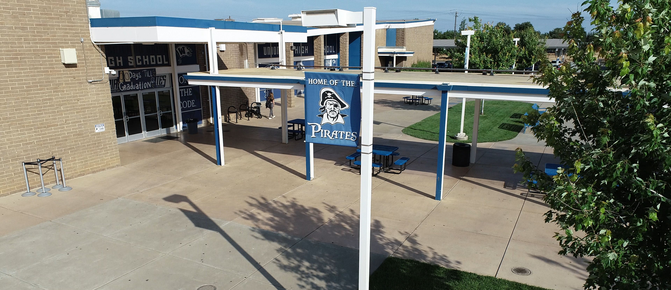

WHEATLAND UNION HIGH SCHOOL
Home Of the Pirates!

Slide 36
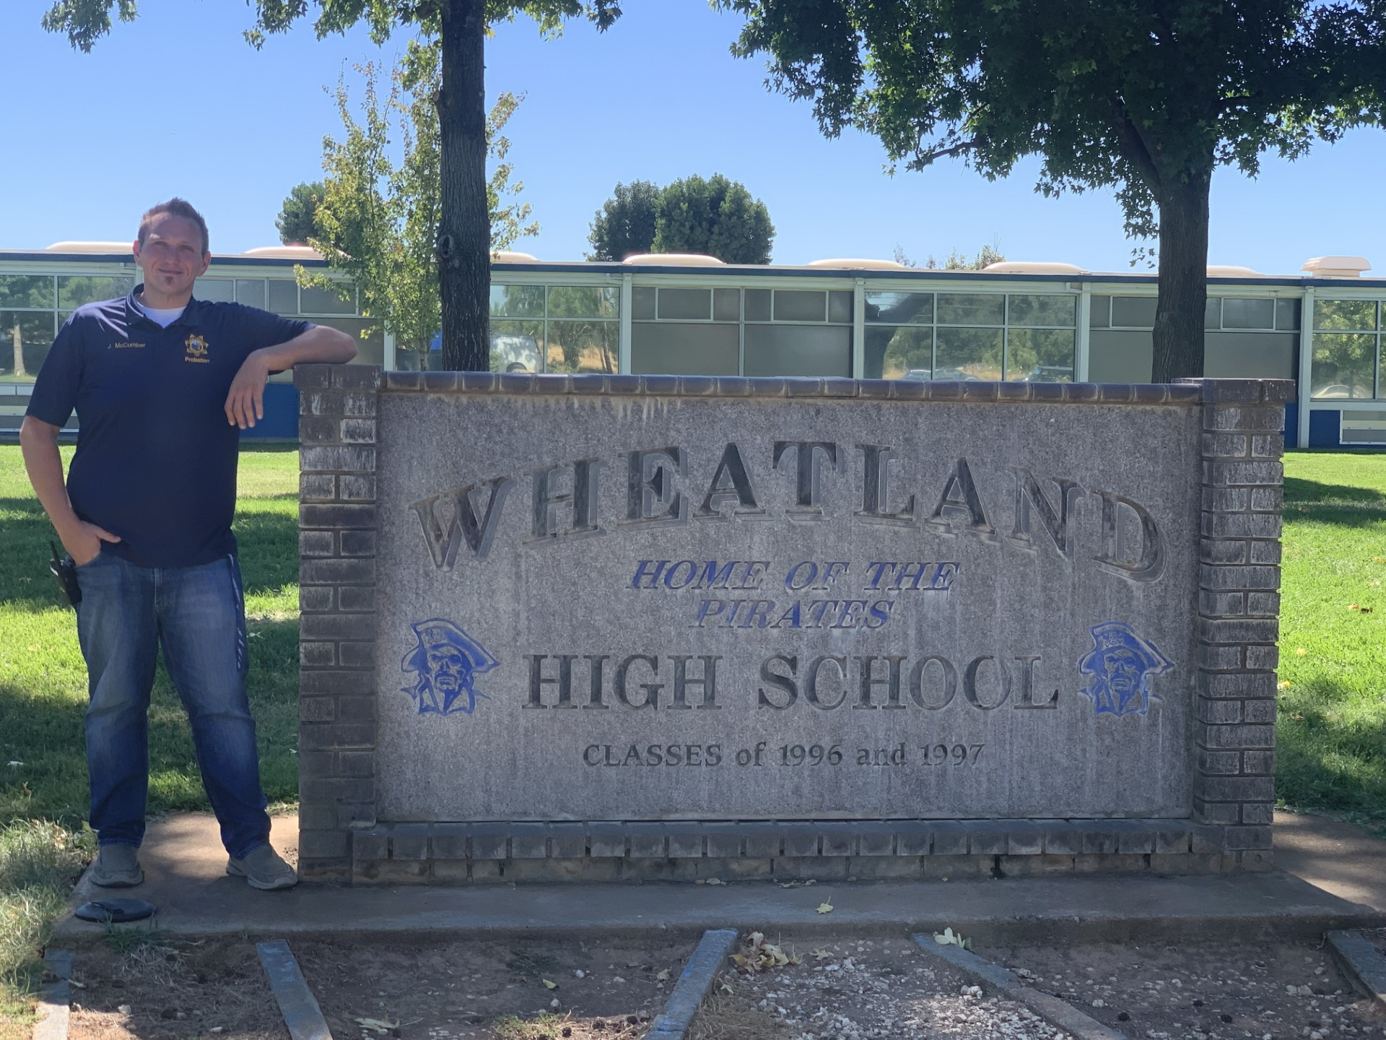
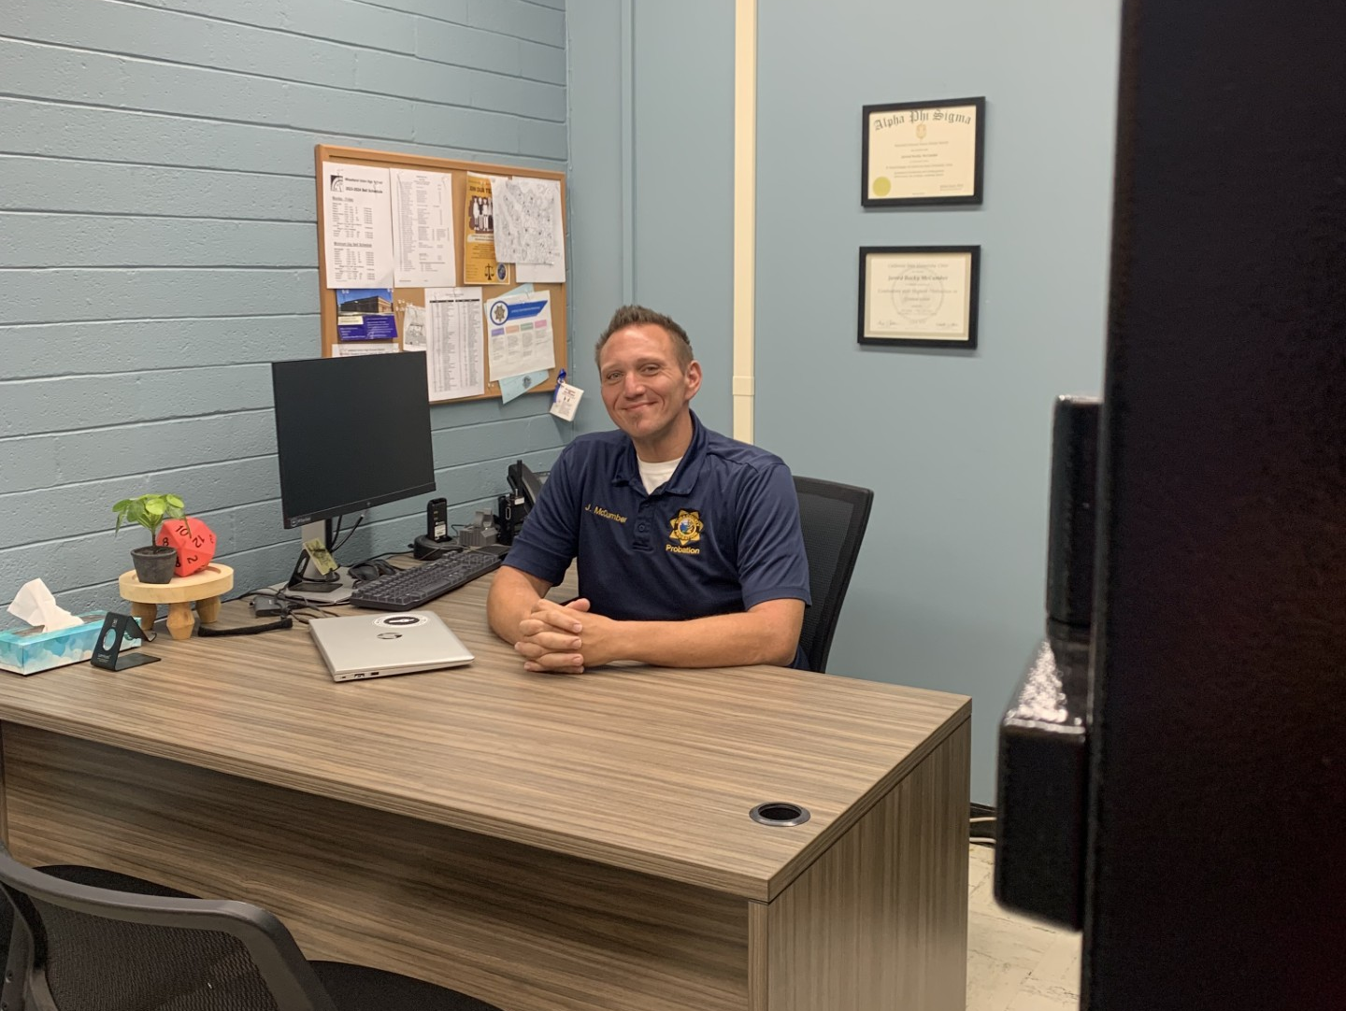
Probation and School Success (P.A.S.S.) Officer
Jarred McCumber
Duties Include
Provide security for significant functions and events throughout the year.
School Dances Rallies/school spirit events
Sporting events Graduation Ceremonies
Lunch/Break time After school activities
Coordinate school services for students.
Member of the Safety and security team.
Assist with Counseling students with behavioral and attendance issues.
Attend Student Attendance Review Board (SARB) hearings as needed
Assist with home visits when needed.
Attend weekly gang meetings that involve school administrators from county wide schools, law enforcement personal, and yuba County Probation.

Slide 37

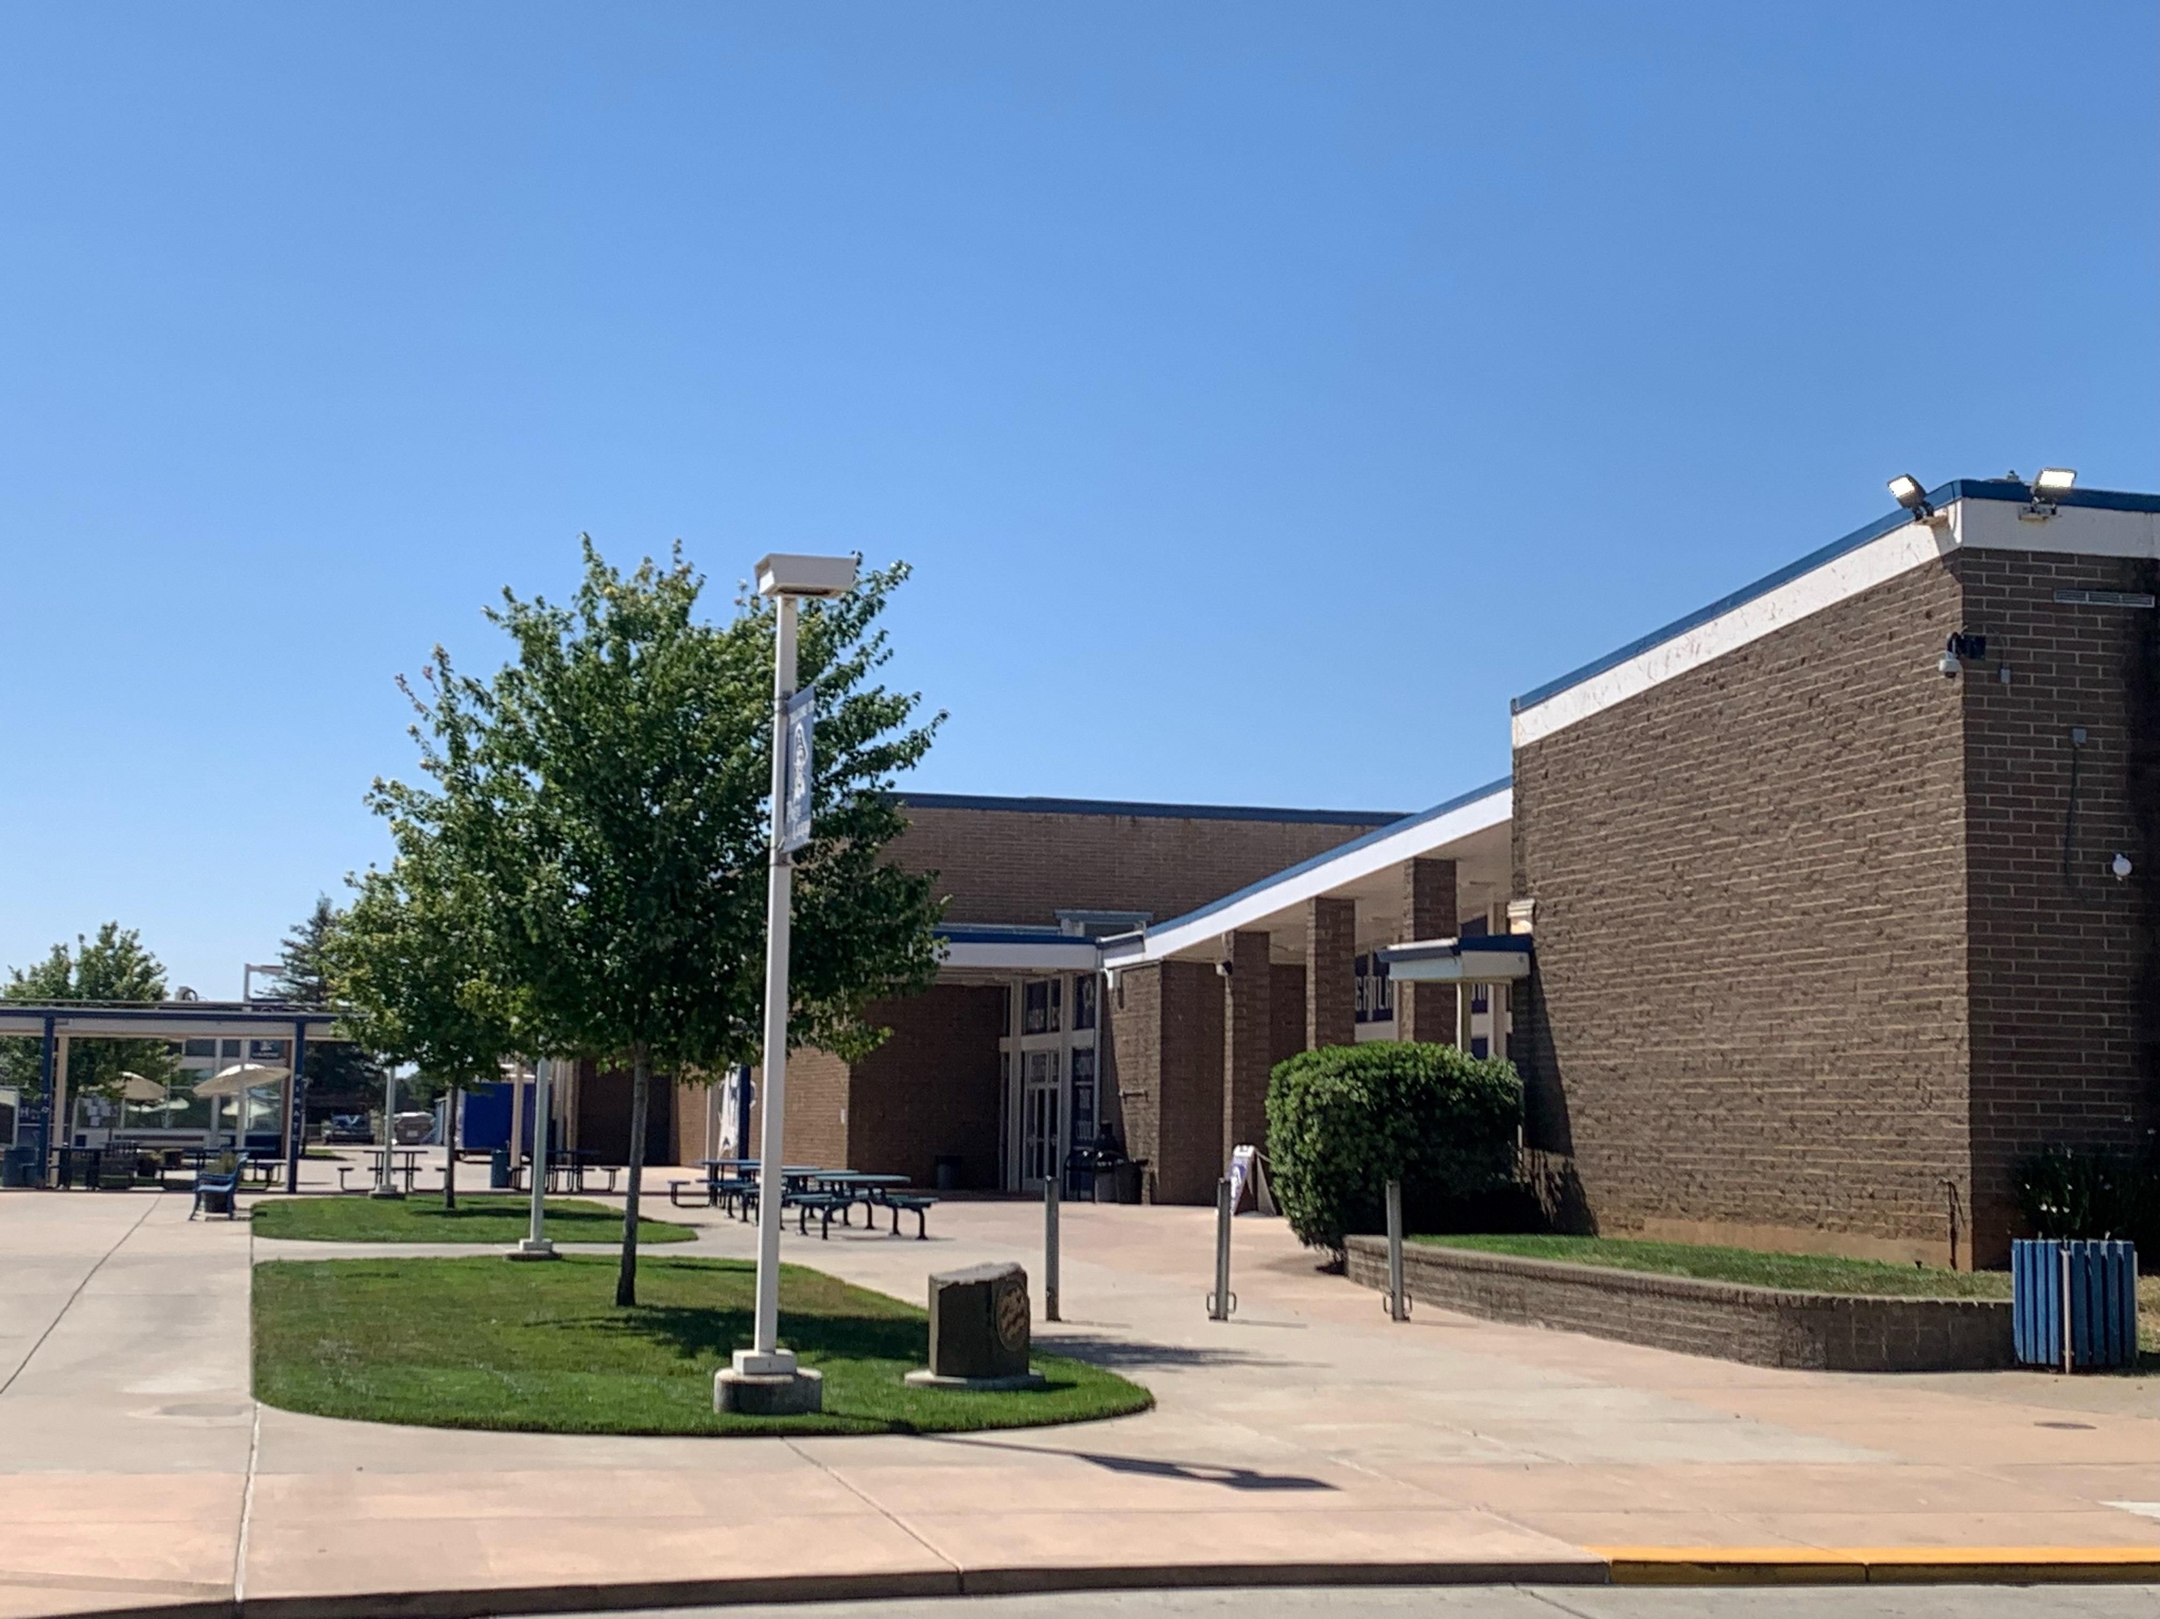
Mission and Vision Statement
“Together Building a foundation for Life.”
Wheatland Union High School sets high standards for both students and staff using a collaborative system of support. We believe every student can obtain academic excellence. Students are given the tools necessary to enhance their work ethic, develop life skills, and utilize today’s technology to create college and career connections that have Real World Relevance.

Slide 38


HONOR THE CODE!
Courteous
Outgoing
Dedicated
Empathetic
Student’s needs come first.
Ethical and honest behavior only.
Learning is an expectation for everyone in our system; students, staff, and leadership.
Accountability for everyone.
Transparent leadership.
Respectful behavior.
Achievement follows expectations.
Every day, Every Child, Whatever it Takes.

Slide 39


Actual Average Attendance Rates
2024/2025 | 94.38%
2023/2024 | 93.87%
2022/2023 | 93.34%
2021/2022 | 94.90%
2020/2021 | 90.77%
2019/2020 | 95.38%
“Success is earned one day at a time, start by showing up.”

Slide 40
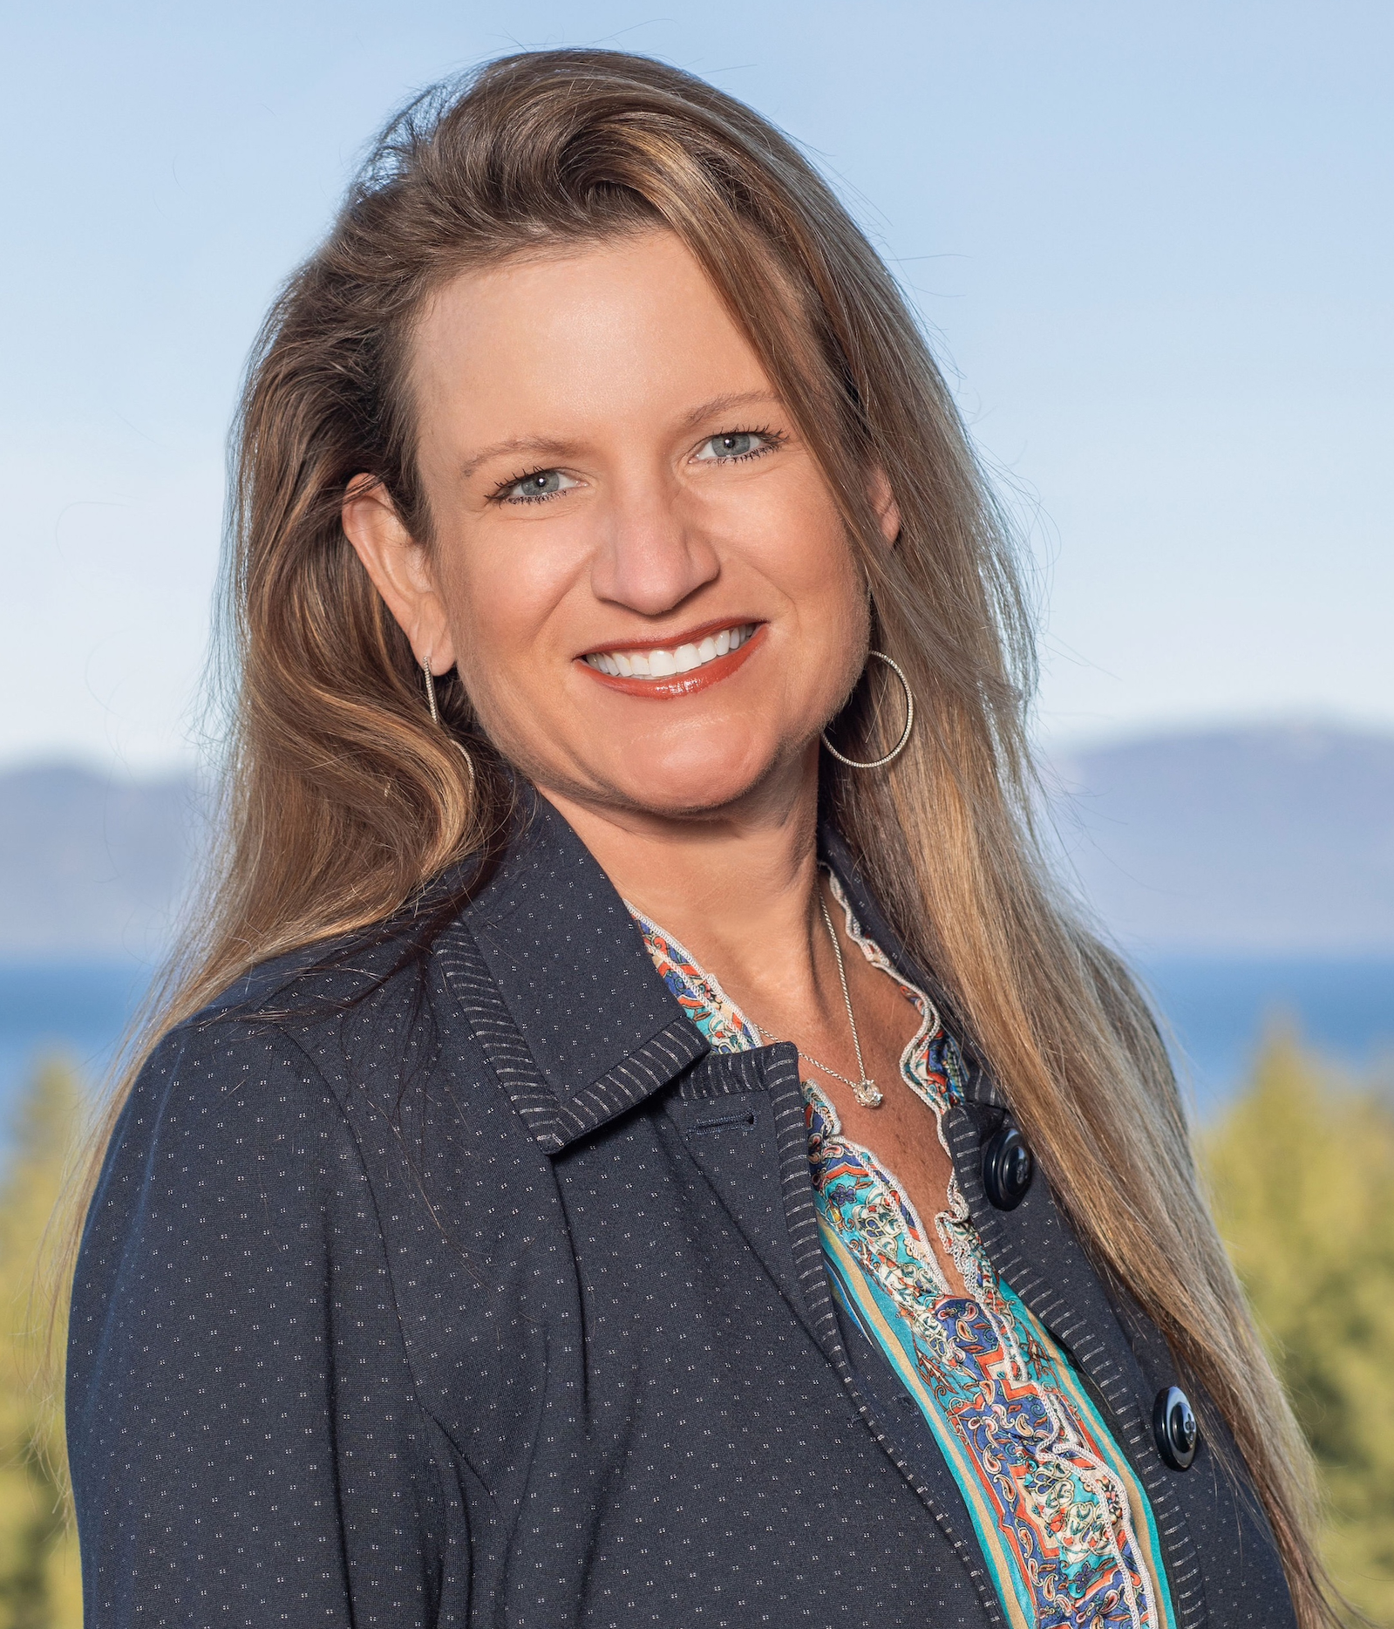
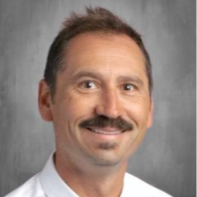
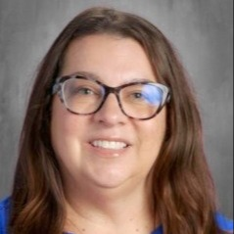
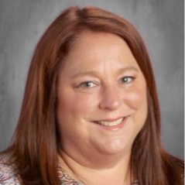
Wheatland Union High School District
Wheatland Union High School Administration Team
Brandon Moore
Principal
Wendy Simpson
Assistant Principal
Heather Sherk
Assistant Principal
Dr. Nicole Newman, Ed.D.
Superintendent

Slide 41

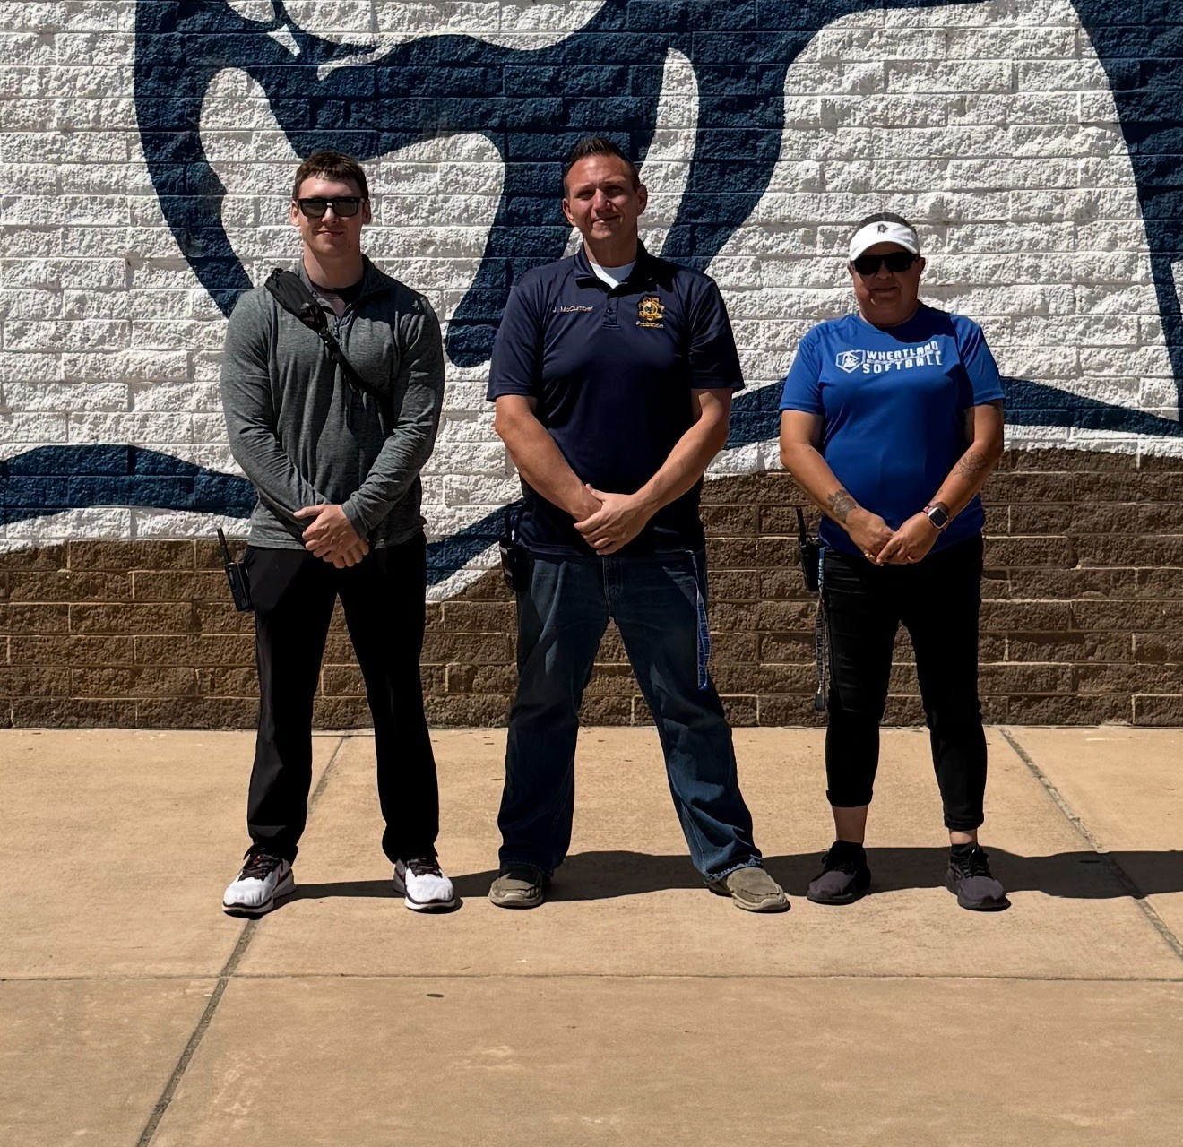
The Security Team
P.A.S.S. Officer-
Jarred McCumber
Campus Supervisor-Sherry Retes
Campus Supervisor-David Cummings

Slide 42
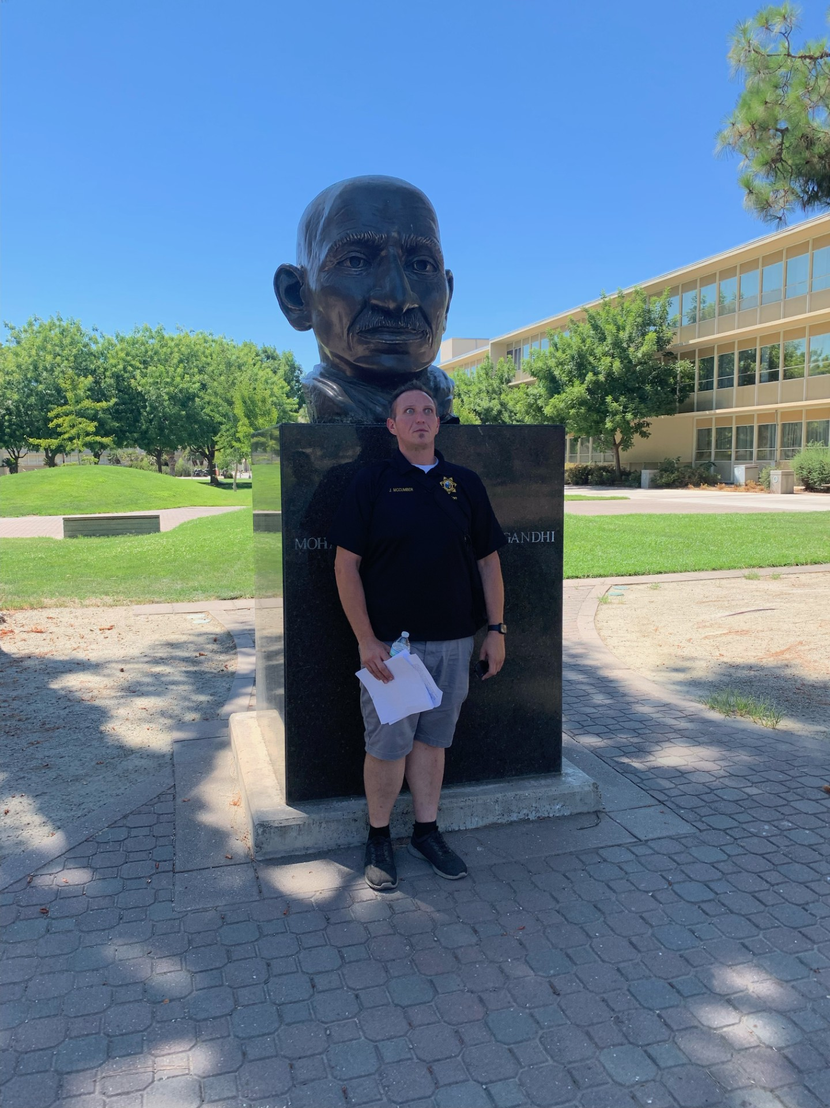
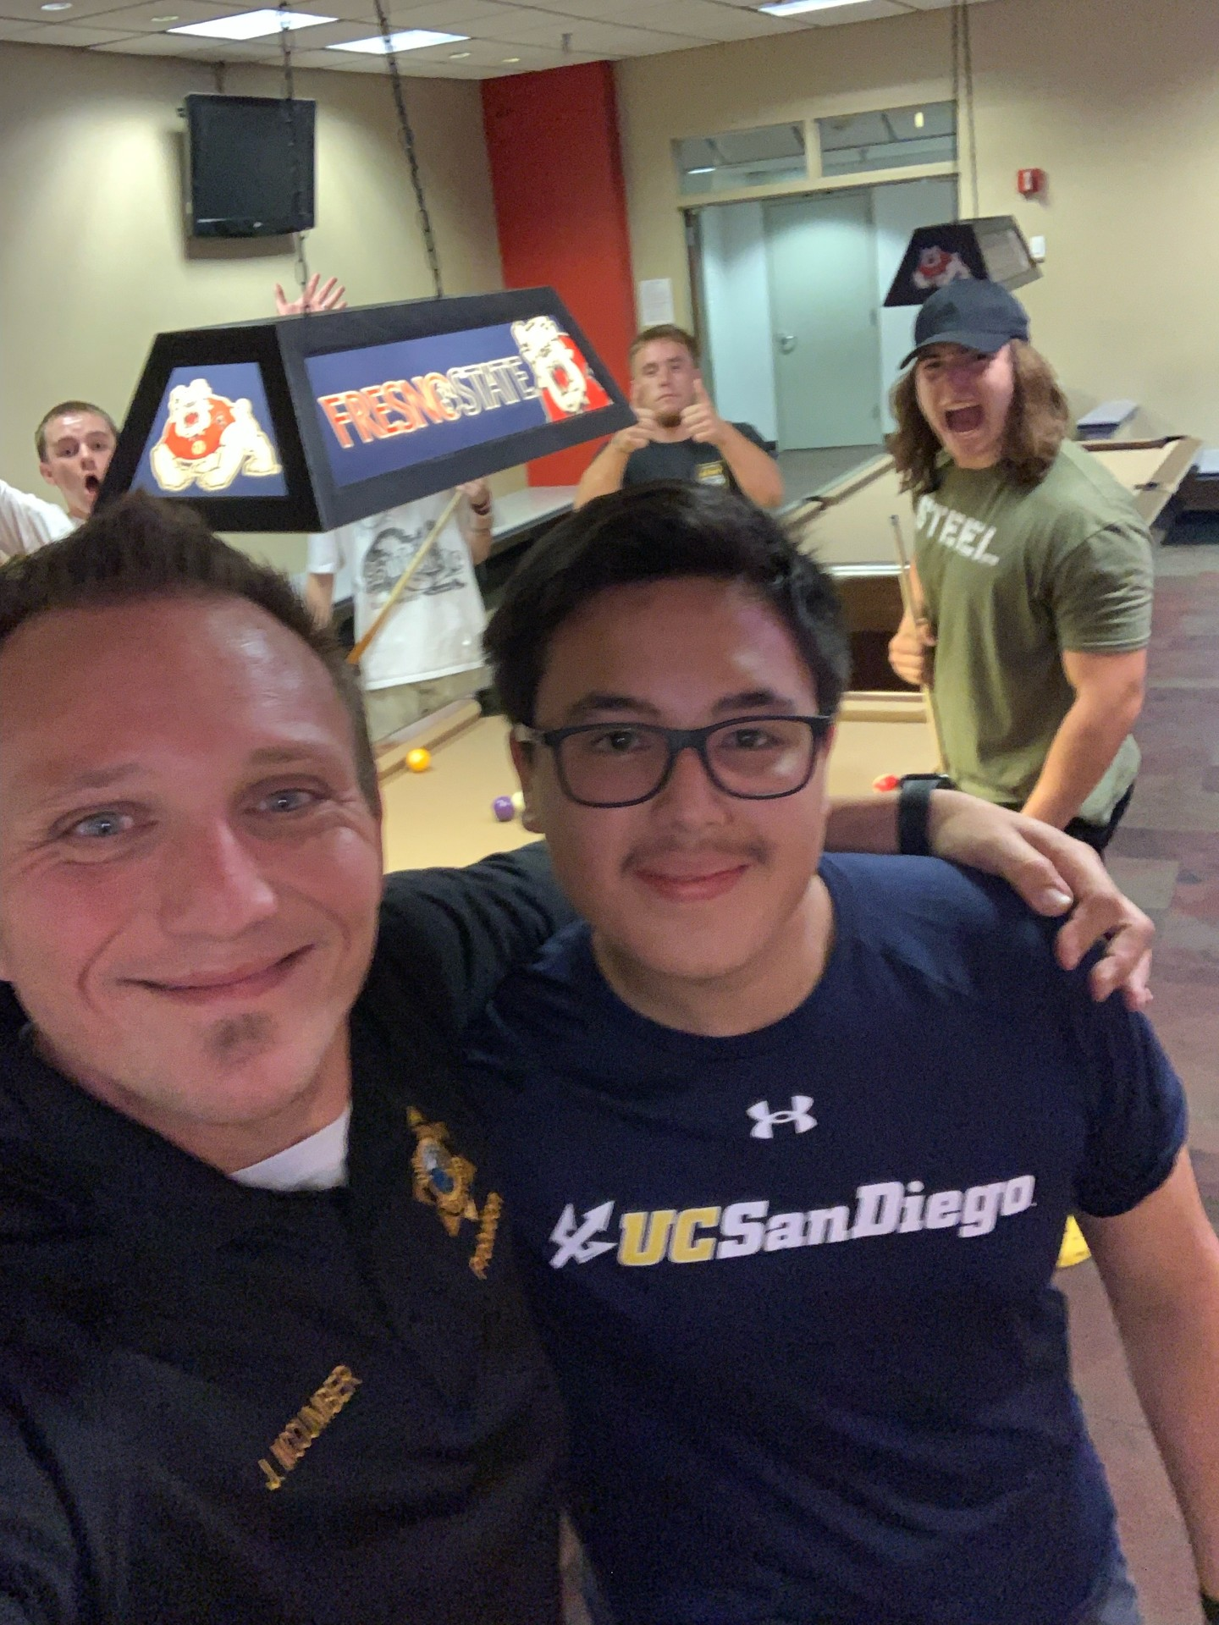
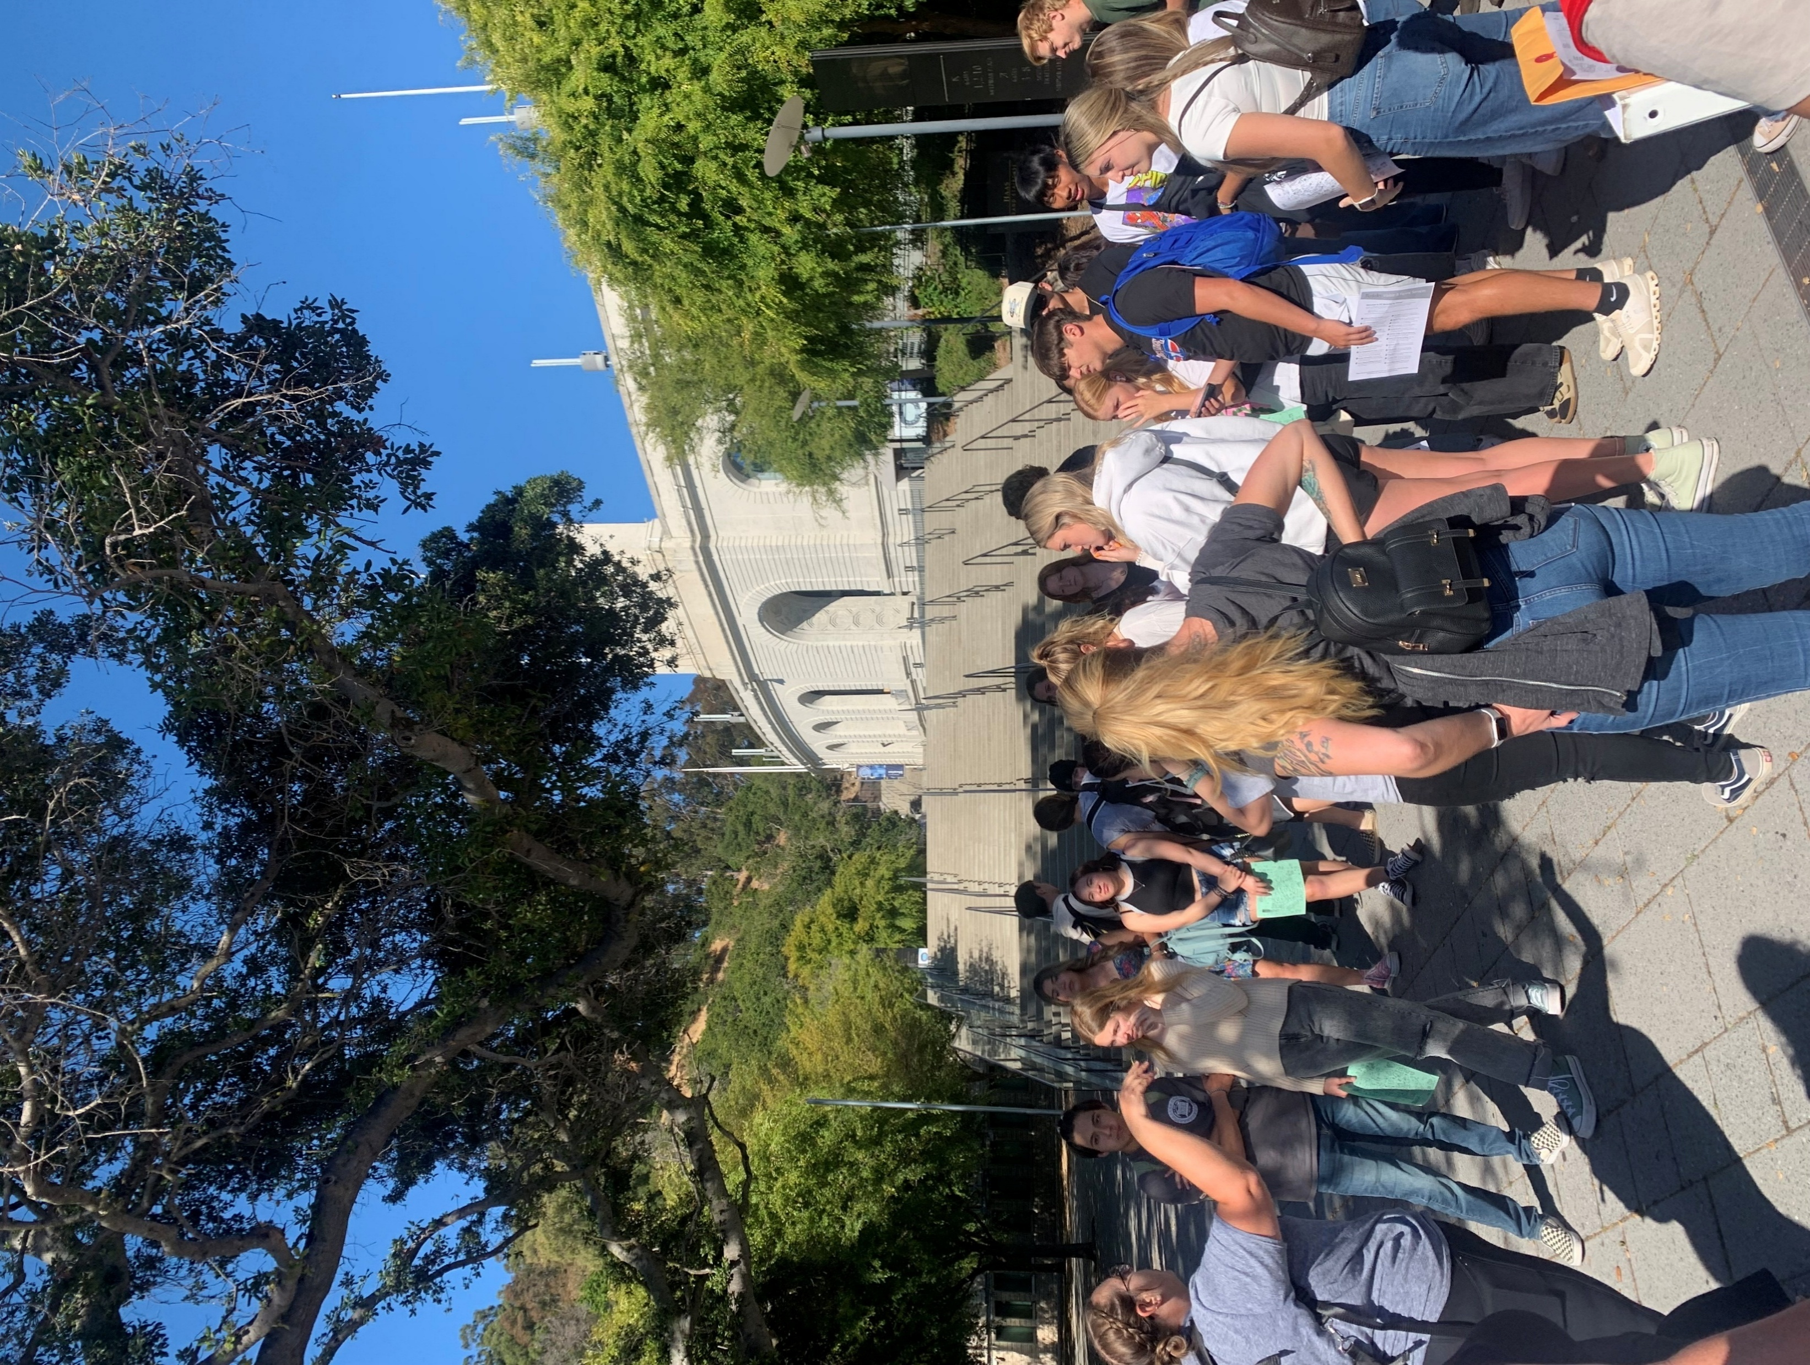
California State University Summer Tour
Colleges toured
San Jose State
Fresno State
UC Merced
Sonoma State
Students had a view into college life with tours of several state colleges led by their P.A.S.S. Officer

Slide 43

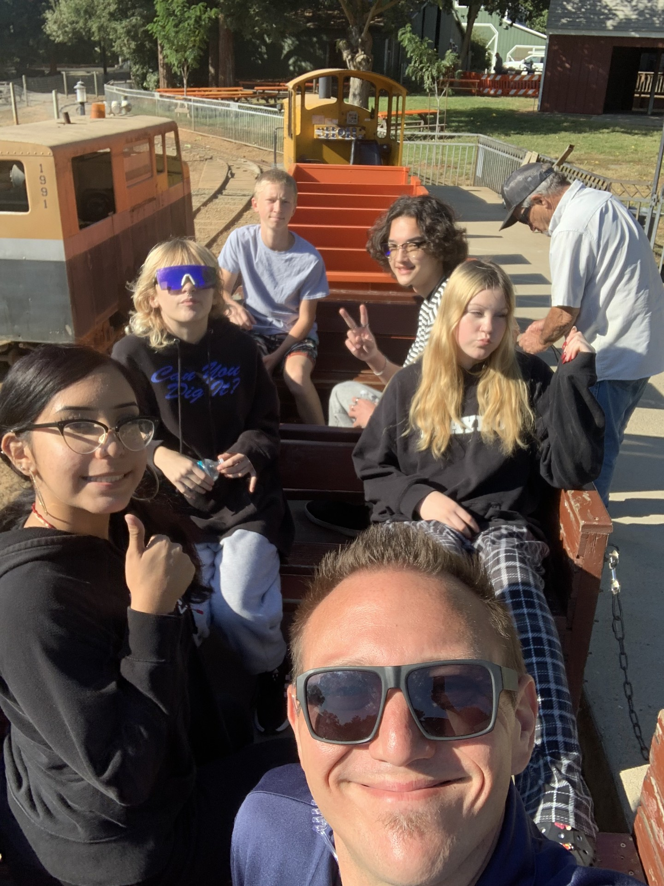
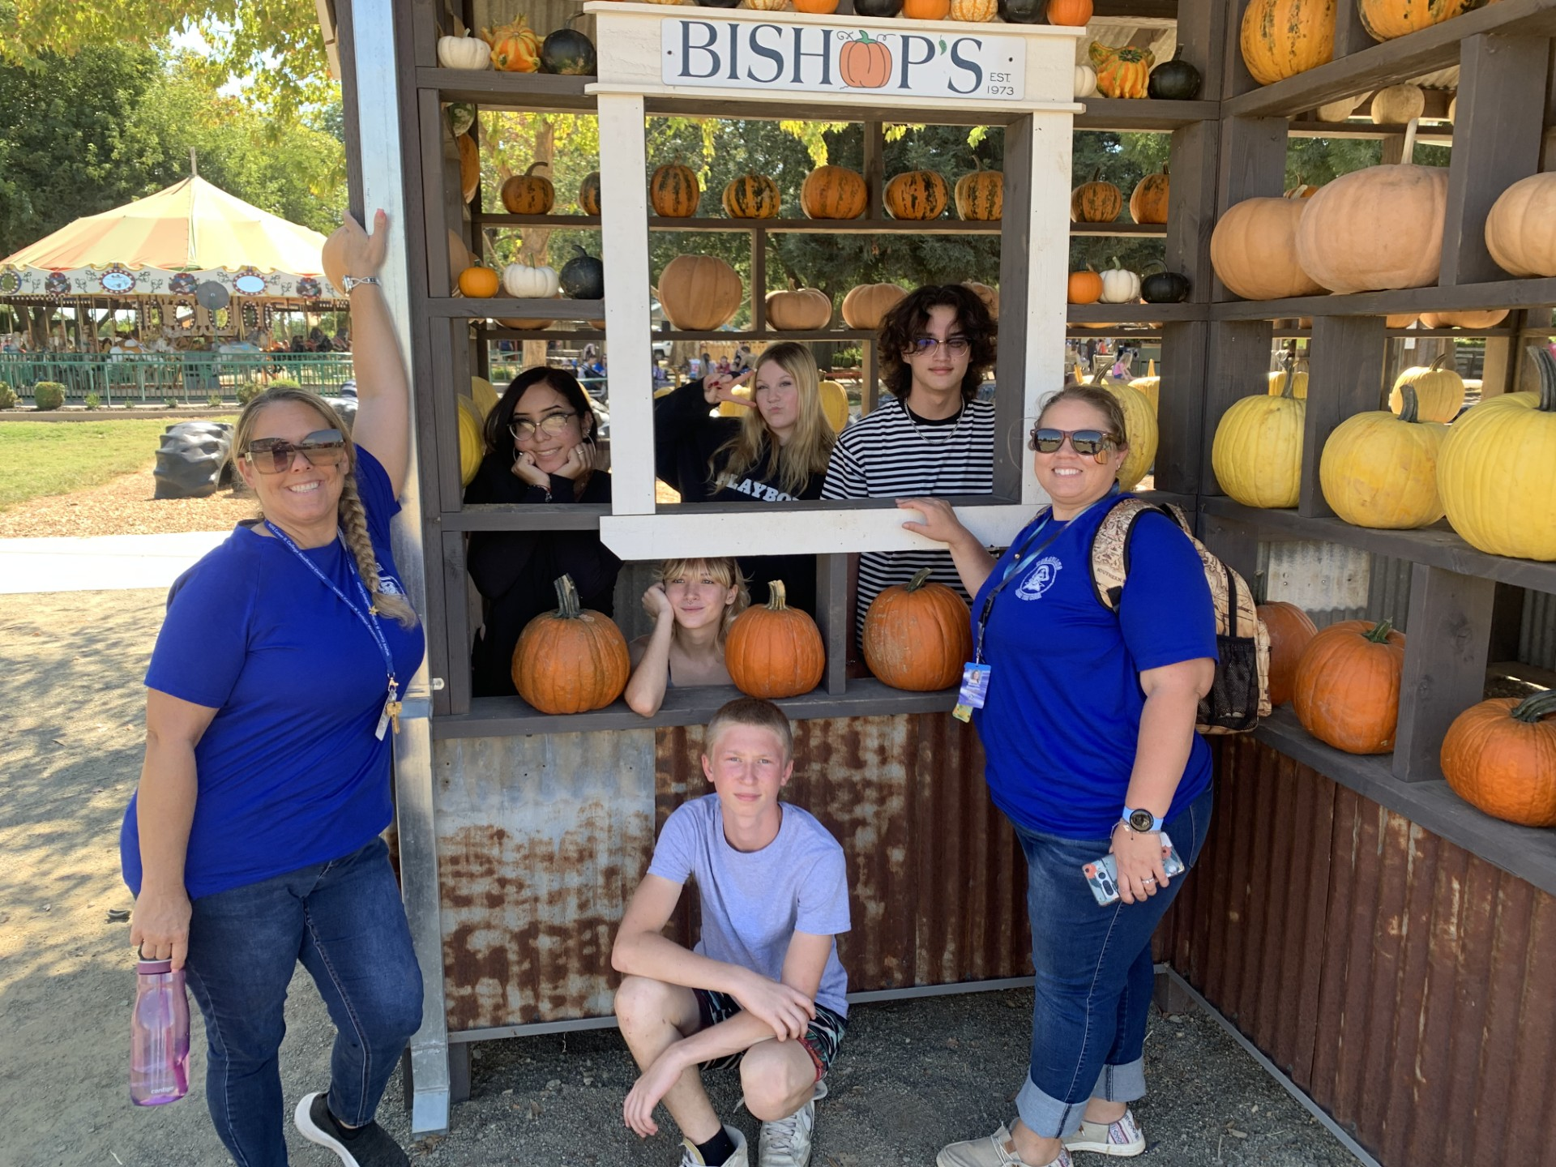
Community Day Trip to Bishop’s Pumpkin Farm
Community Day School Students who earned good grades and had positive behavior were given the opportunity to enjoy a trip to Bishop’s Pumpkin farm.

Slide 44
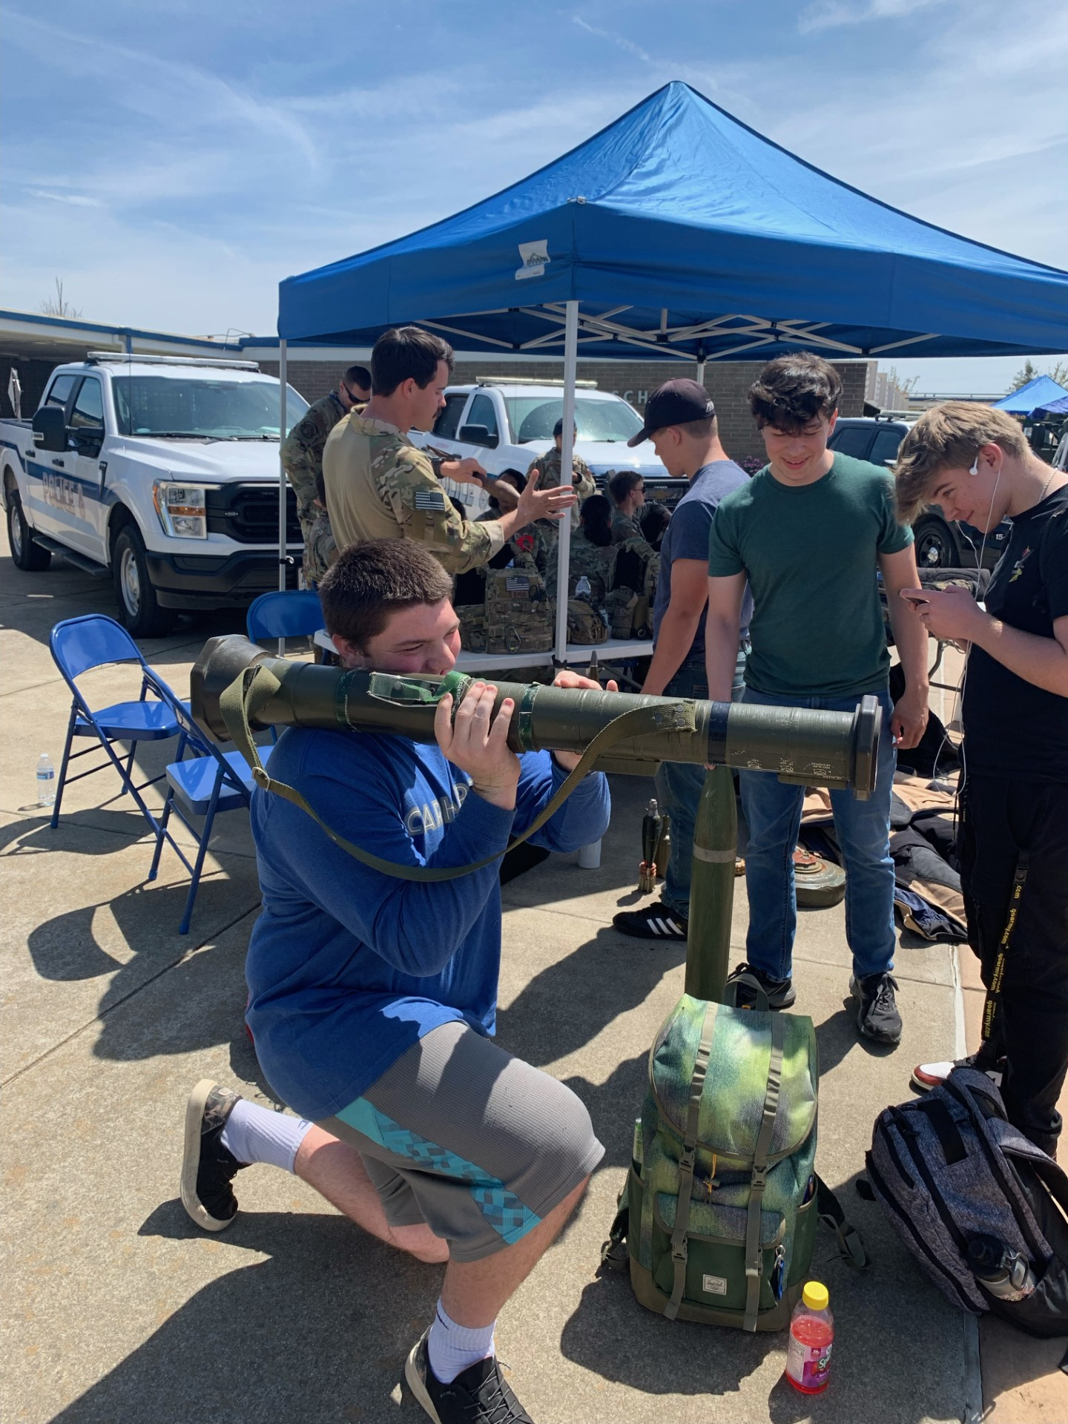
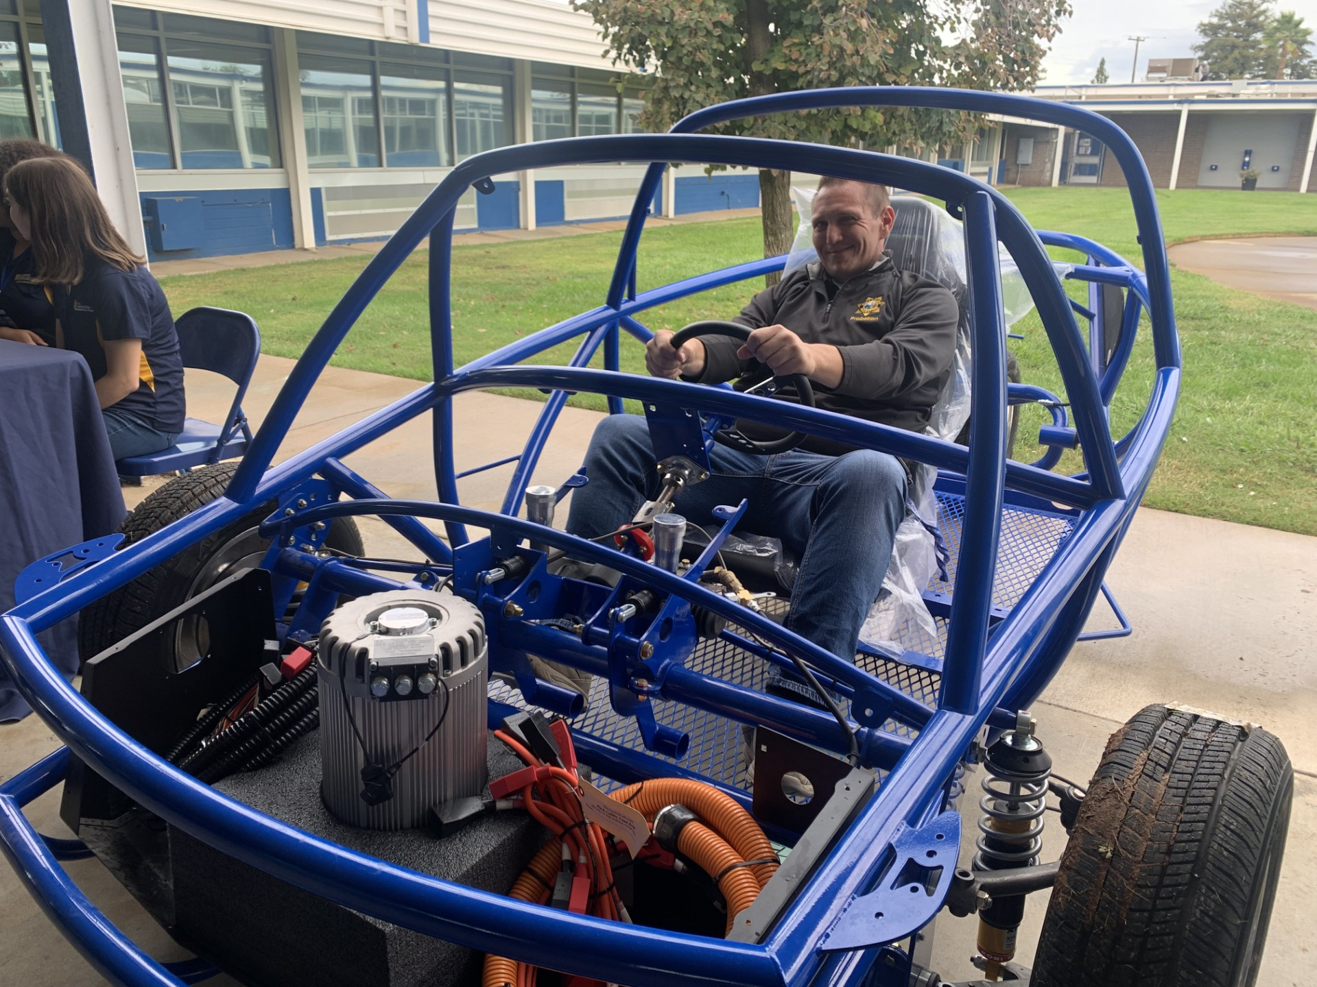
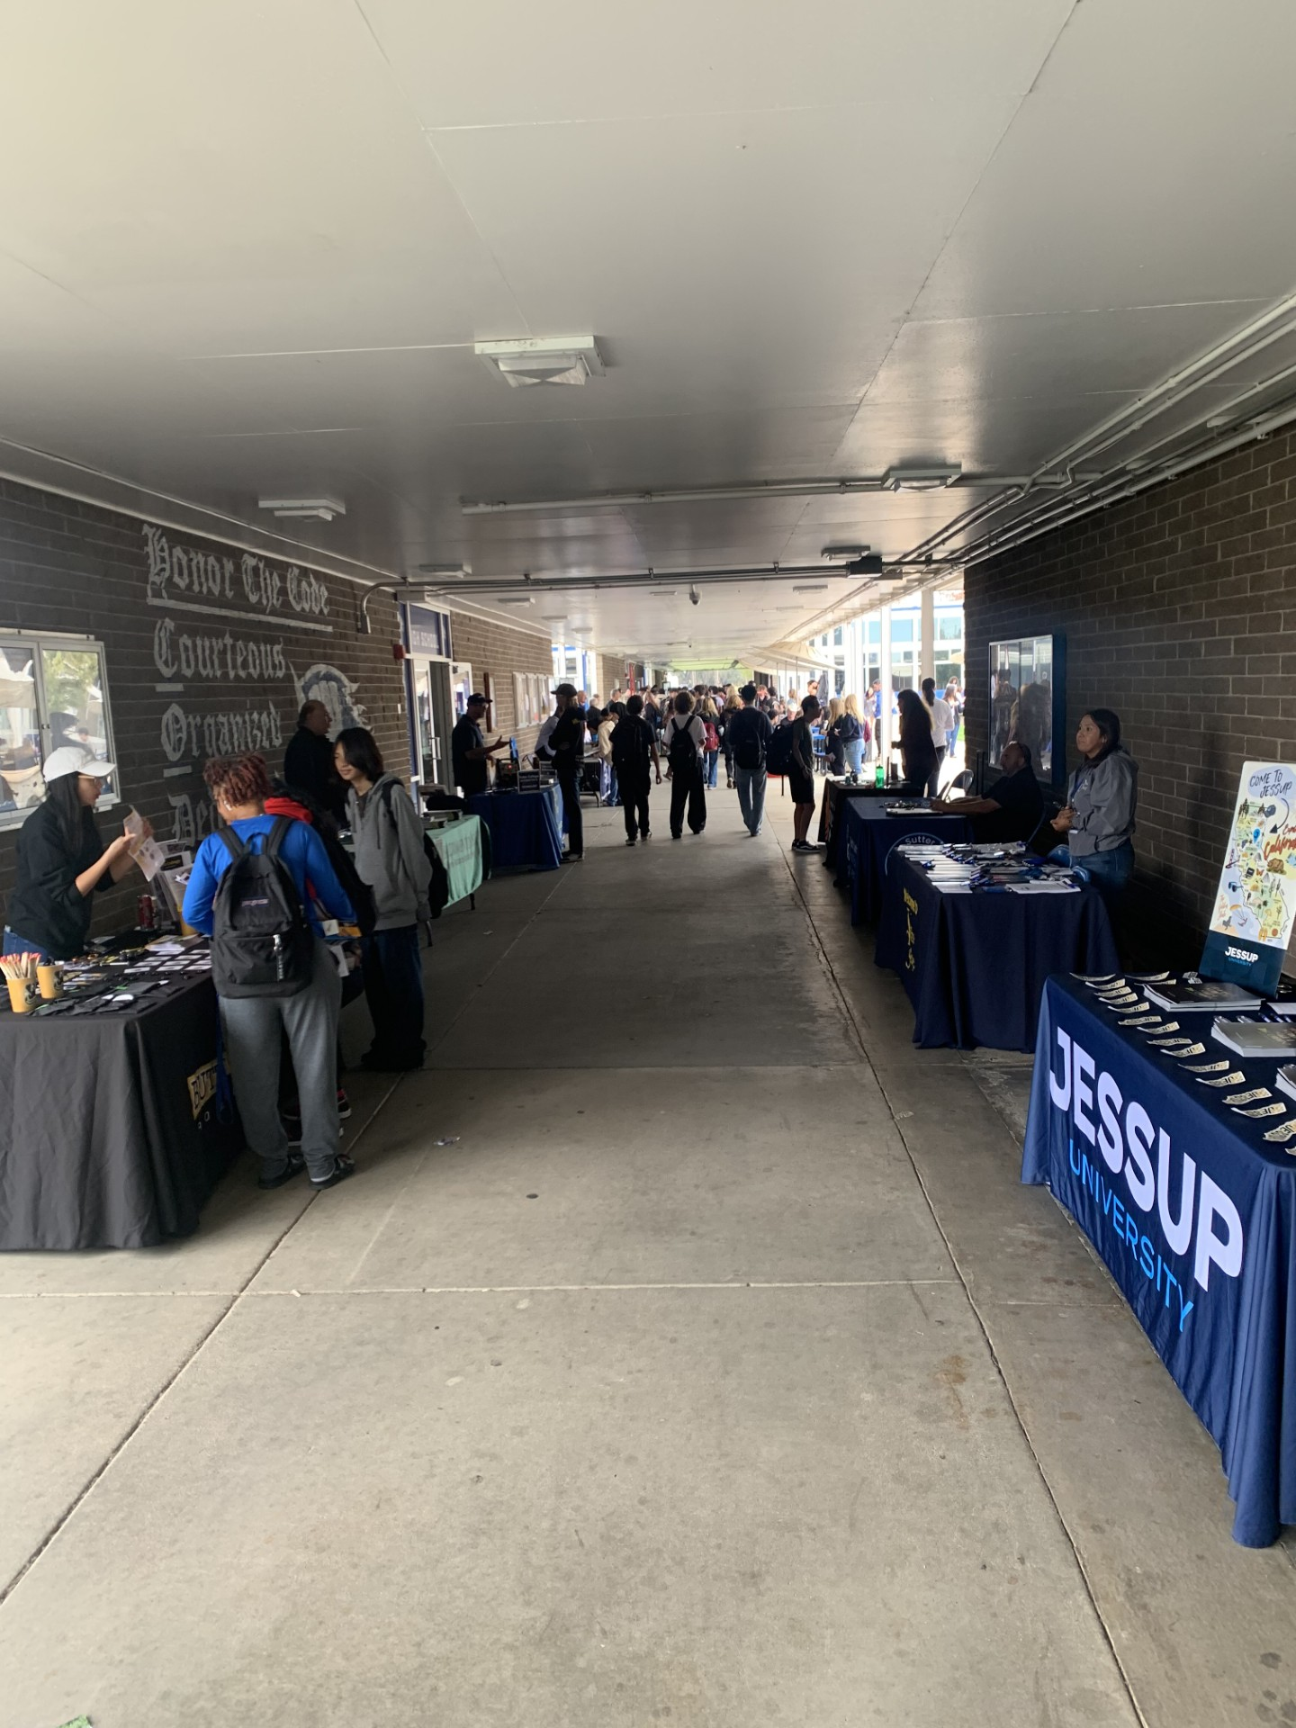

College and Career Day
Students learn about all the college and career options for their bright future.
AHOY!

Slide 45
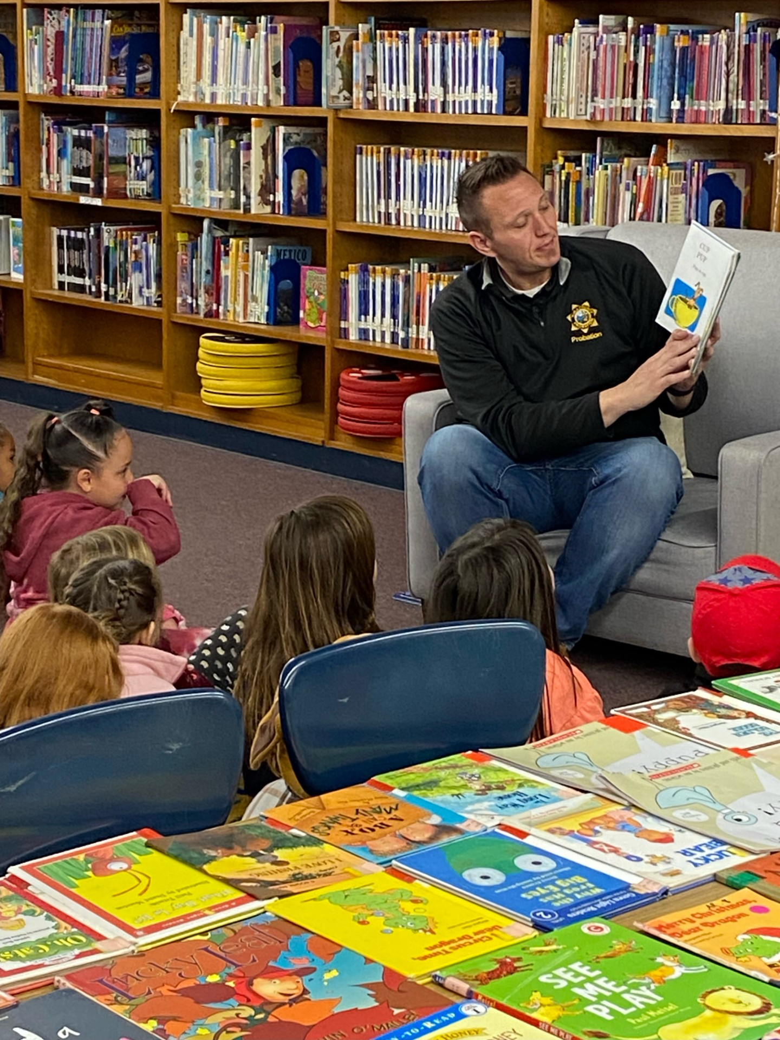

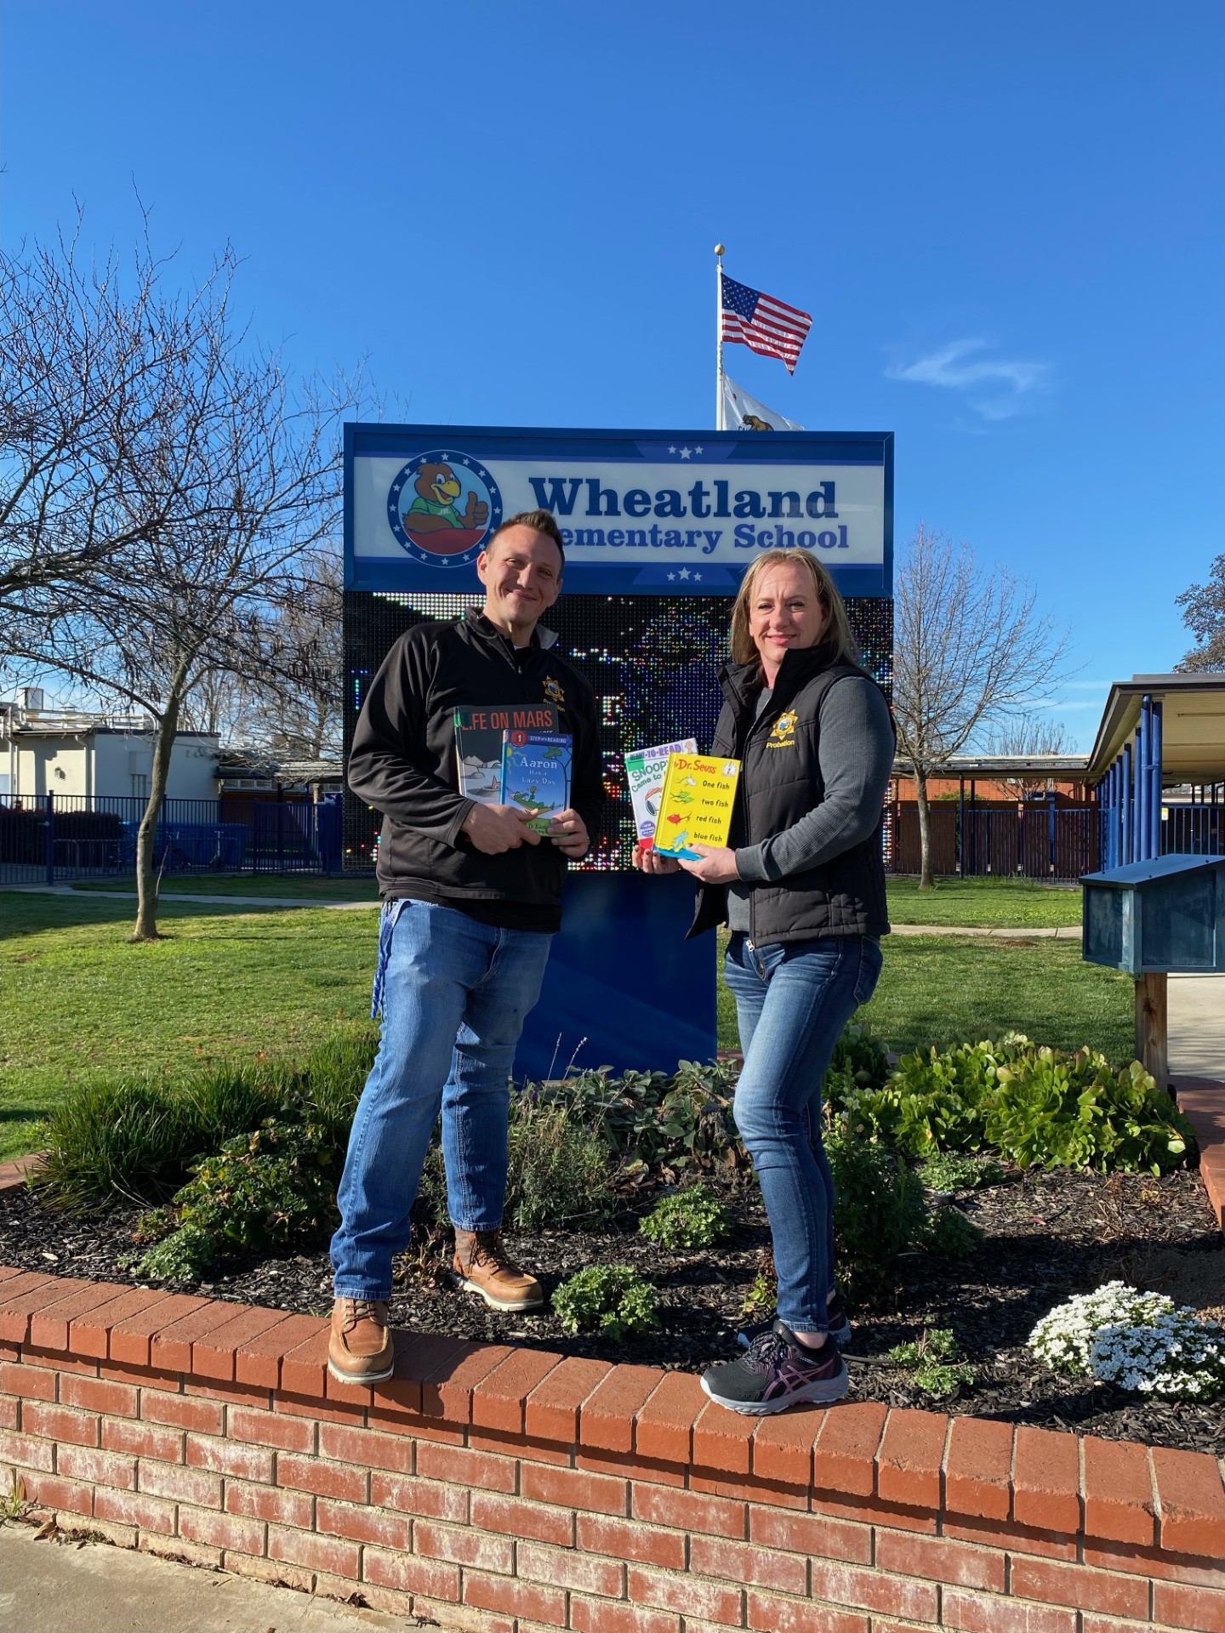

National Read Across America Day
March 2nd is Dr. Seuss’ Birthday. This day is celebrated as National Read Across America Day where the P.A.S.S. Officer Jarred McCumber and Yuba County Truancy Officer Heather Wolfe were invited to read to the students at Wheatland Elementary.

Slide 46
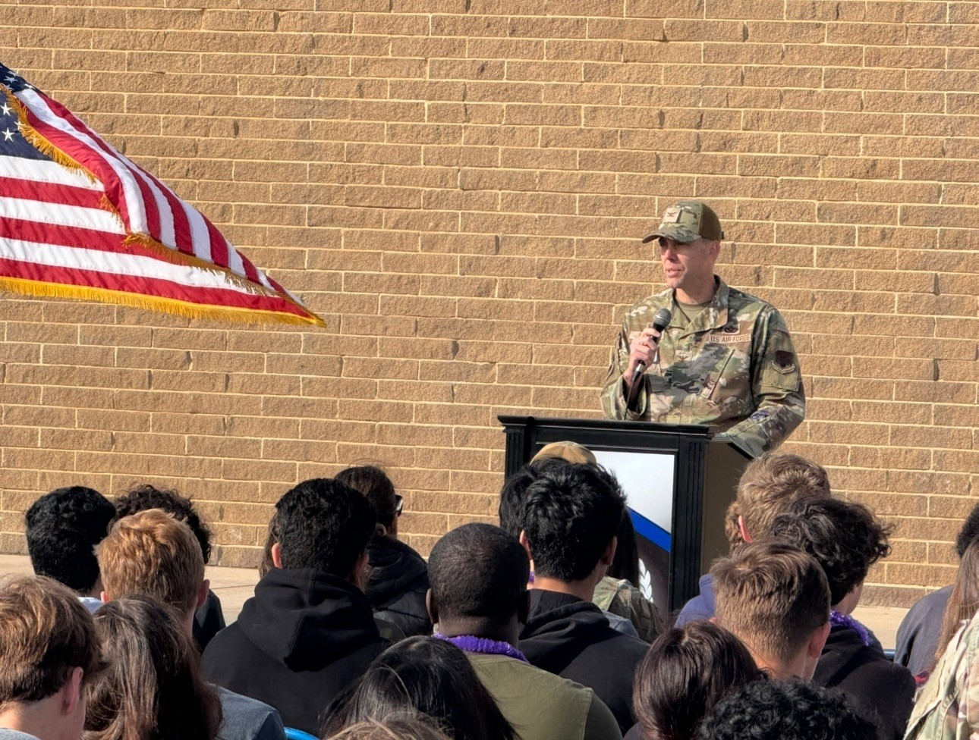
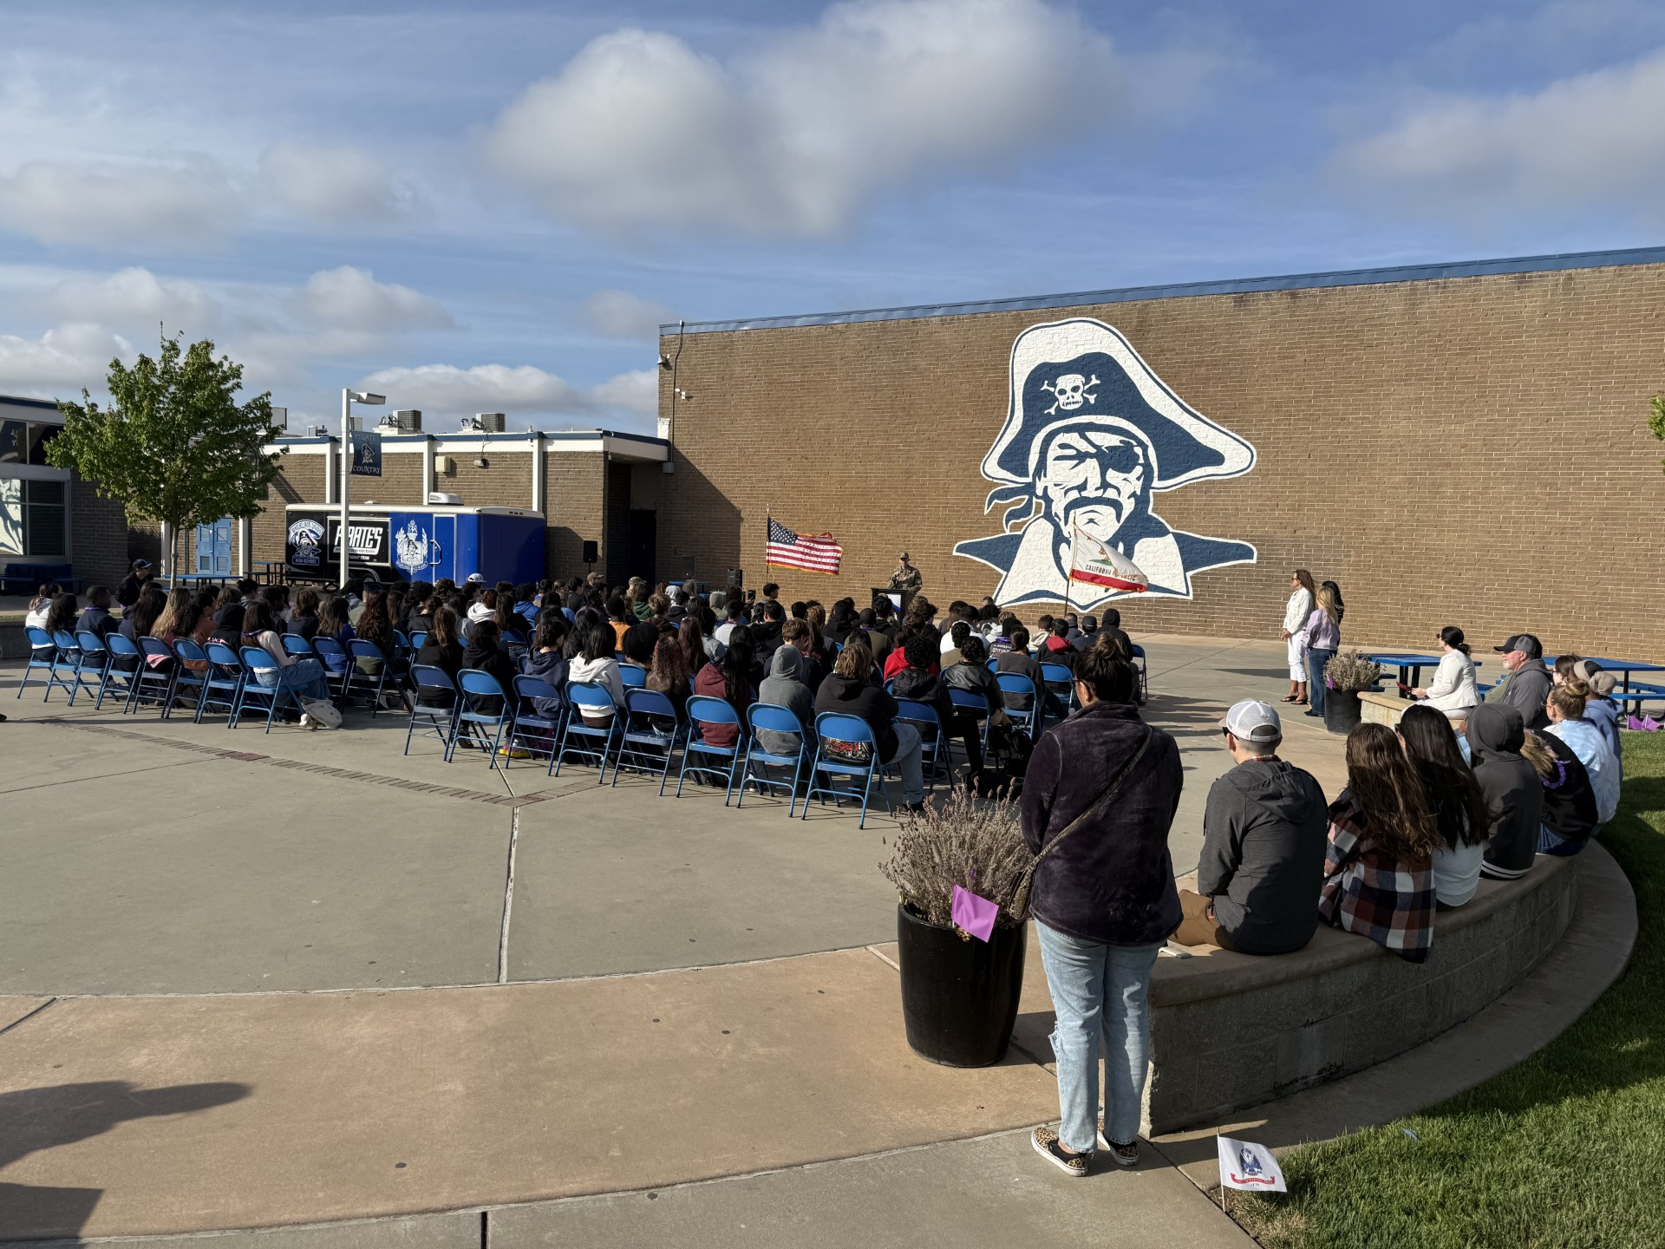

Purple Star Award Ceremony
Wheatland Union High School was awarded the Purple star school designation from the state. Beale leadership and Senator Megan Dahle recognized this award and presented certificates to
the school.
This award recognizes the commitment support the school provides military connected youth.

Slide 47
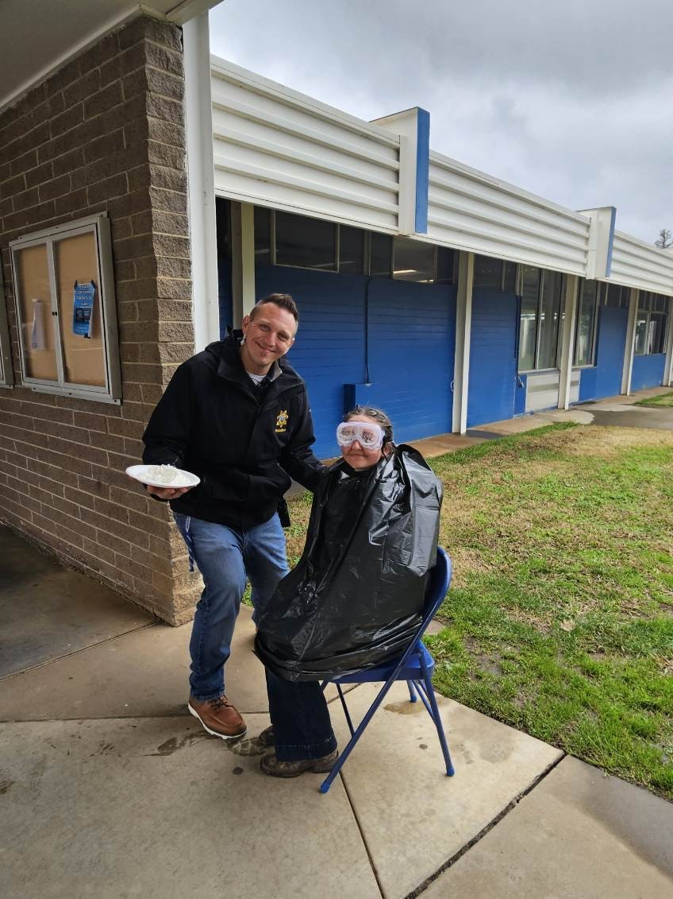
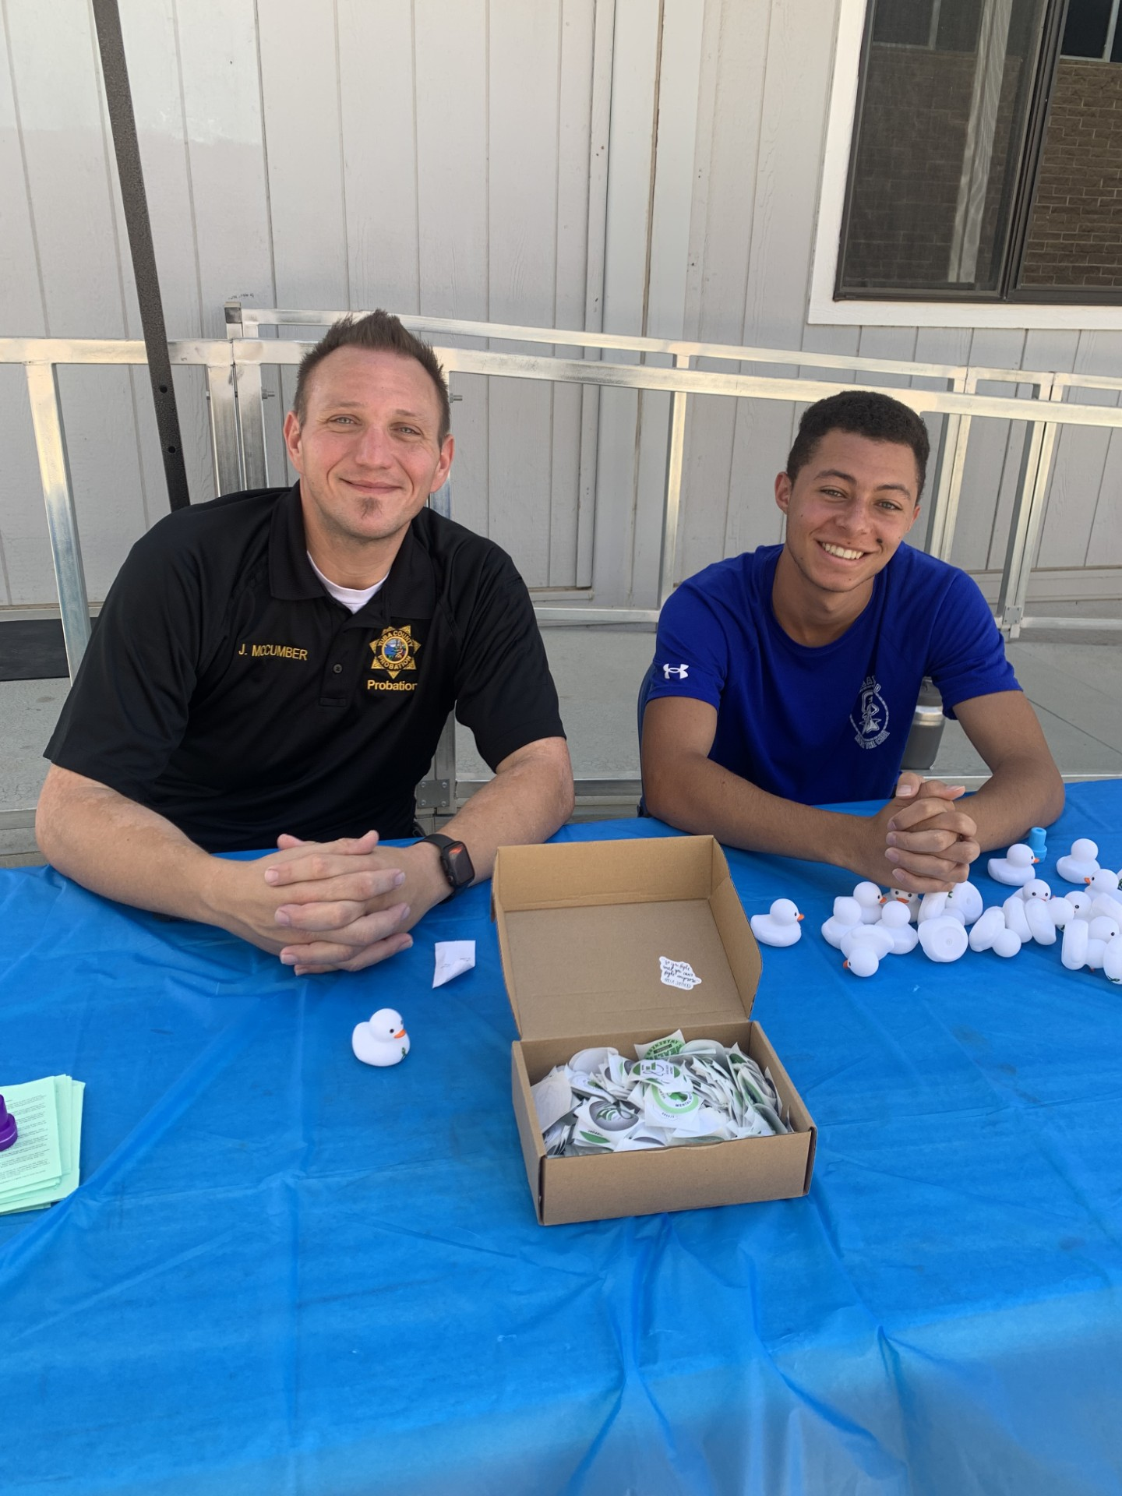
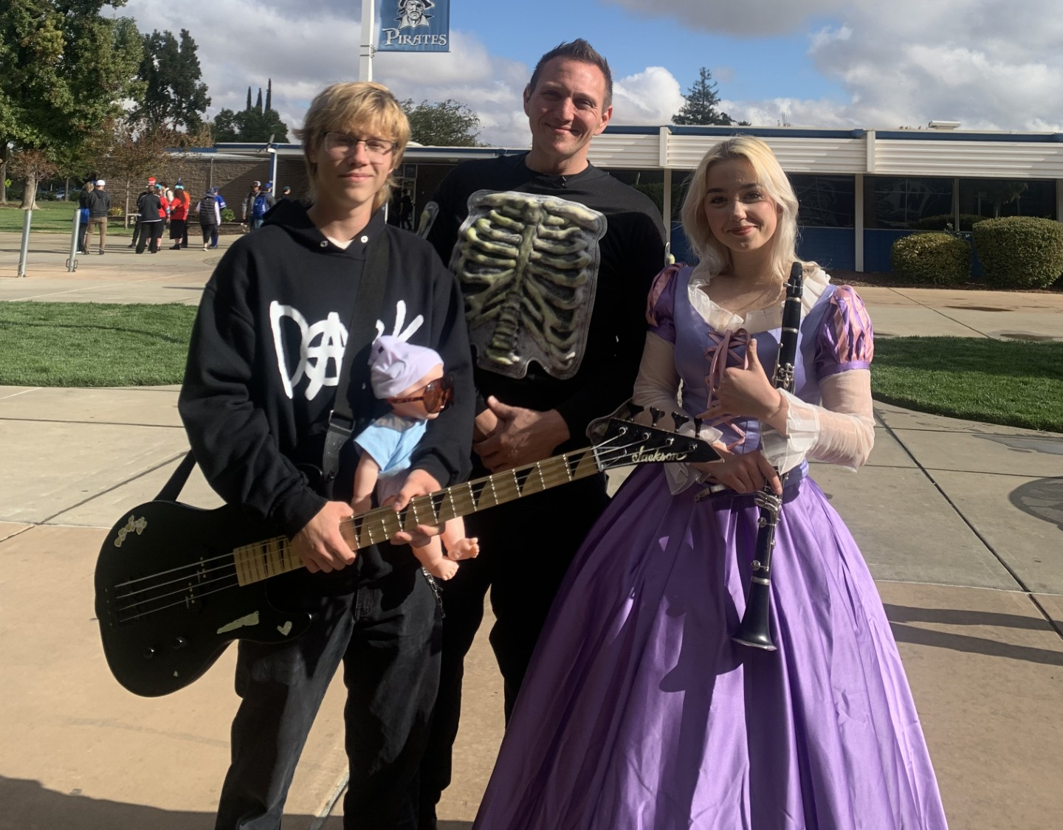
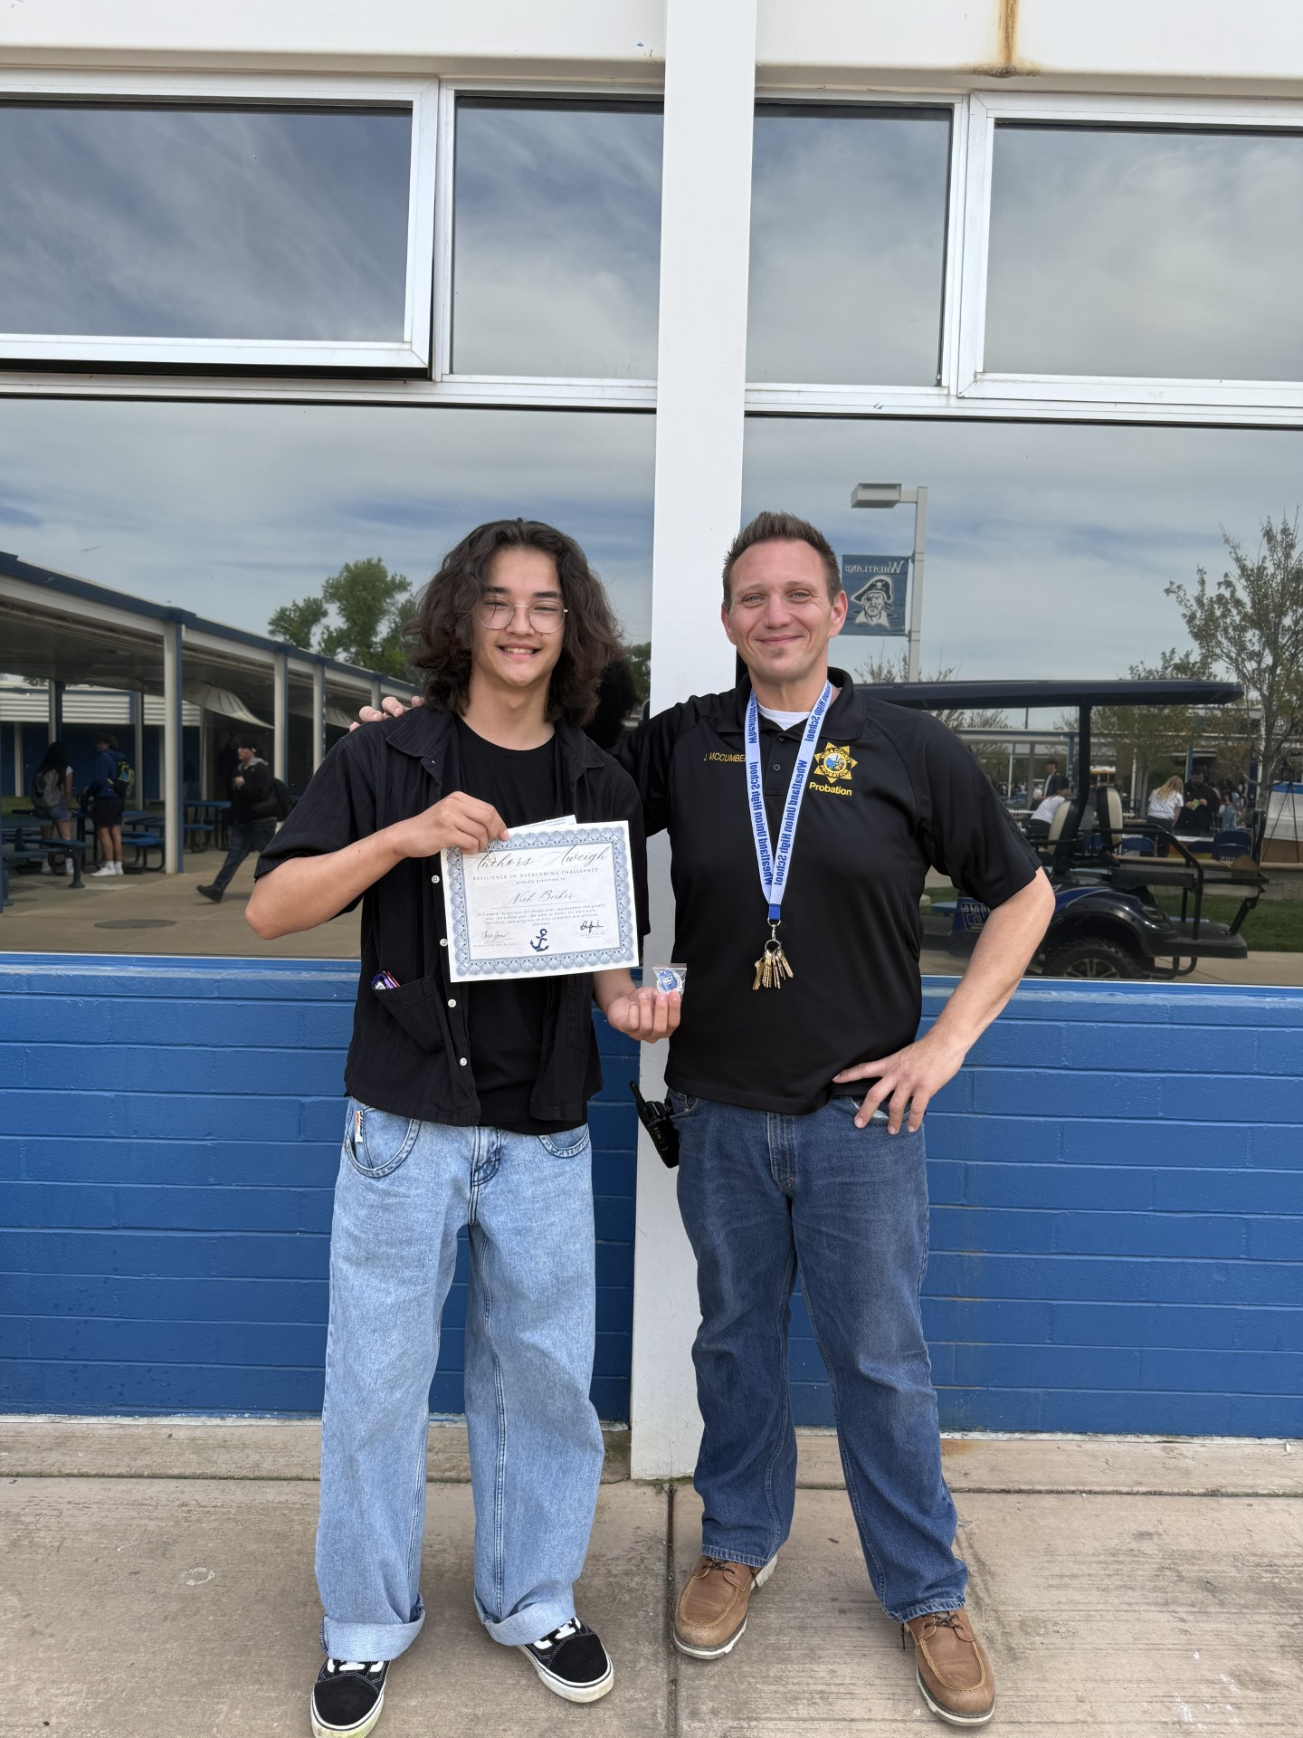
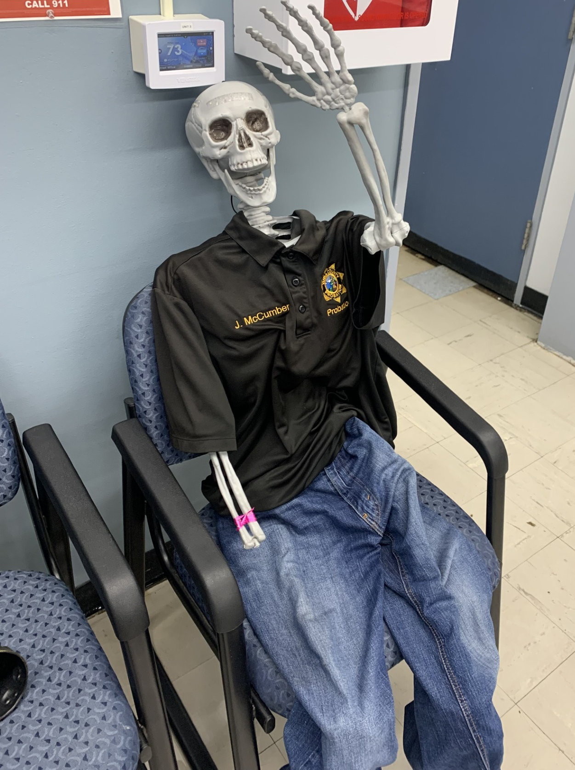
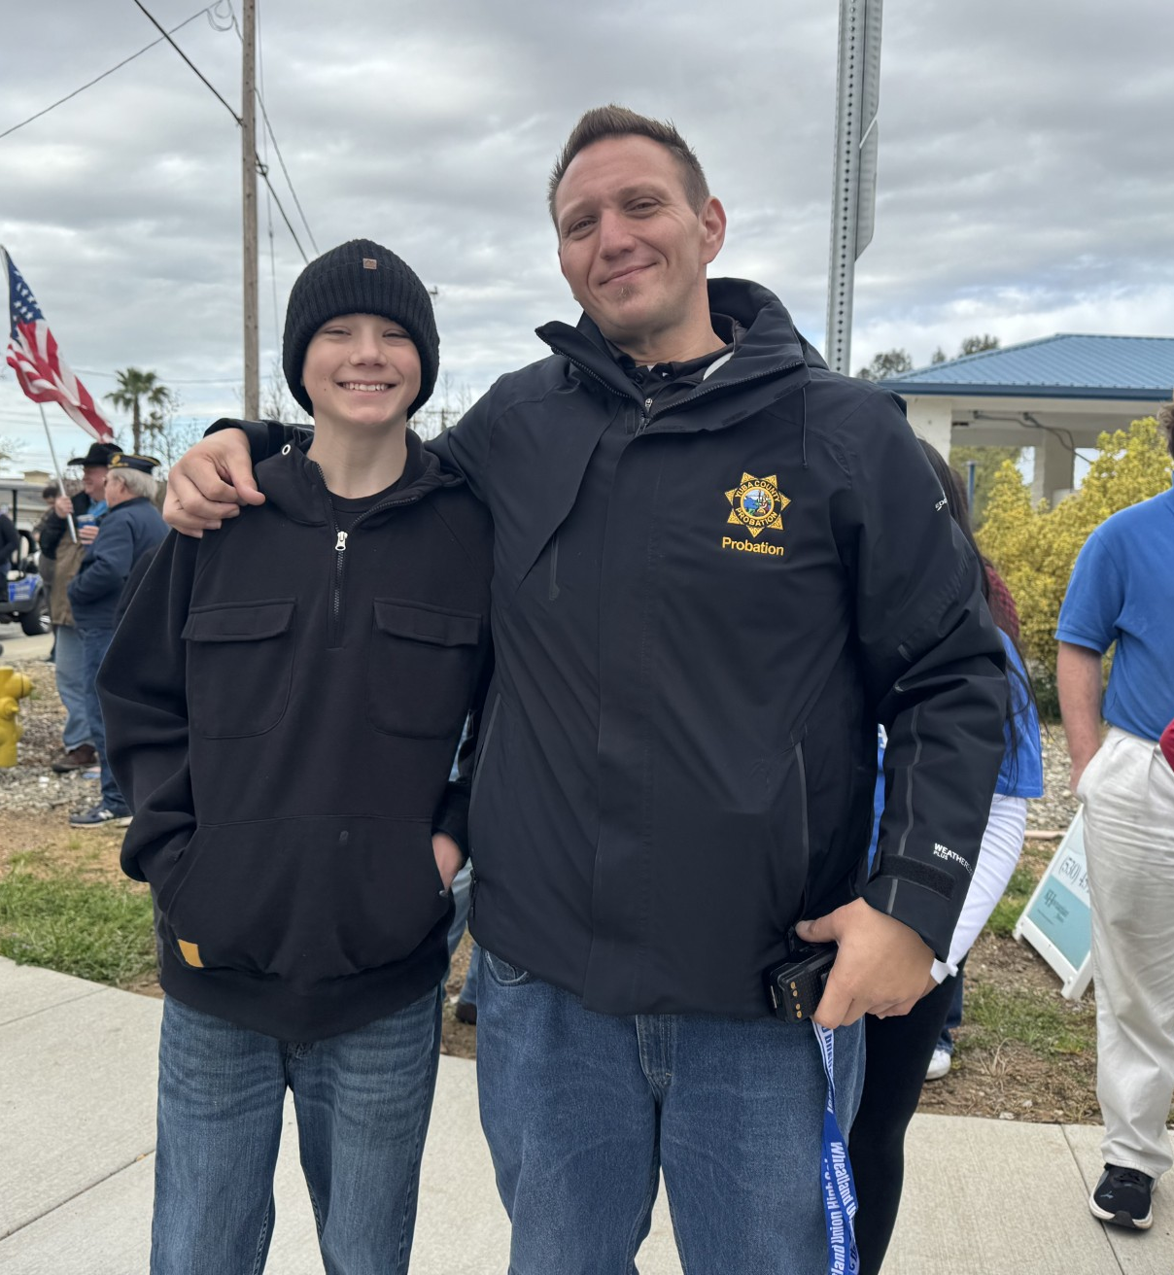
Making a Difference
Let’s go Pirates

Slide 48
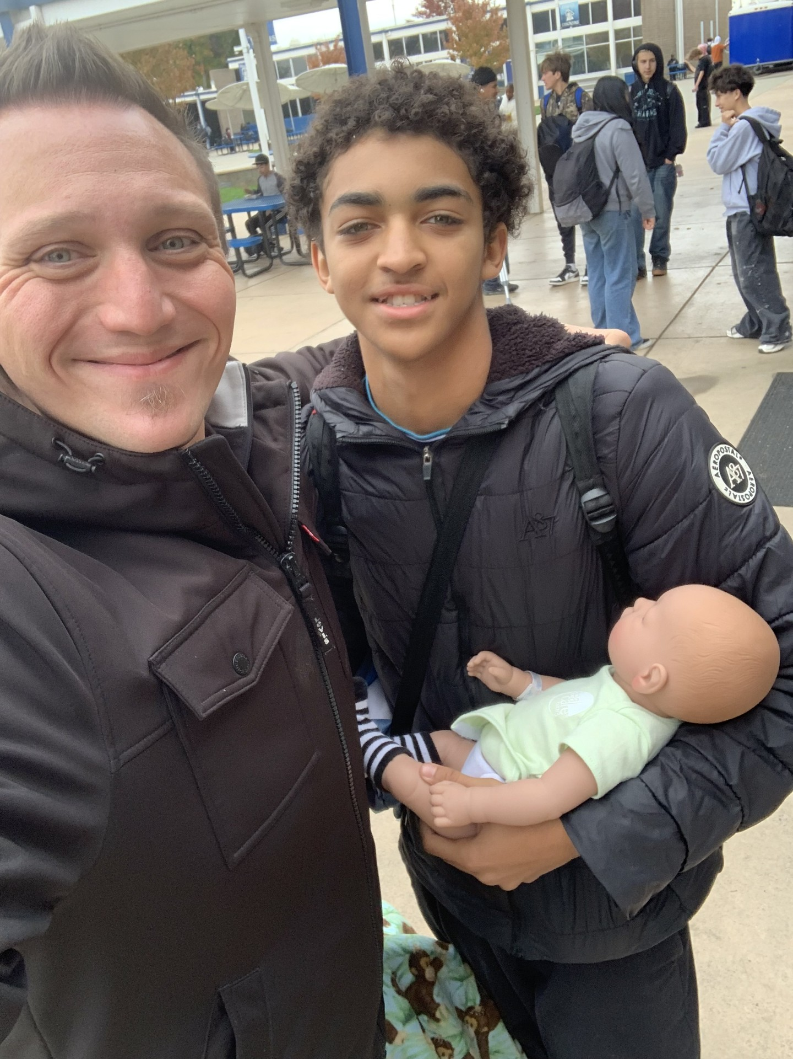
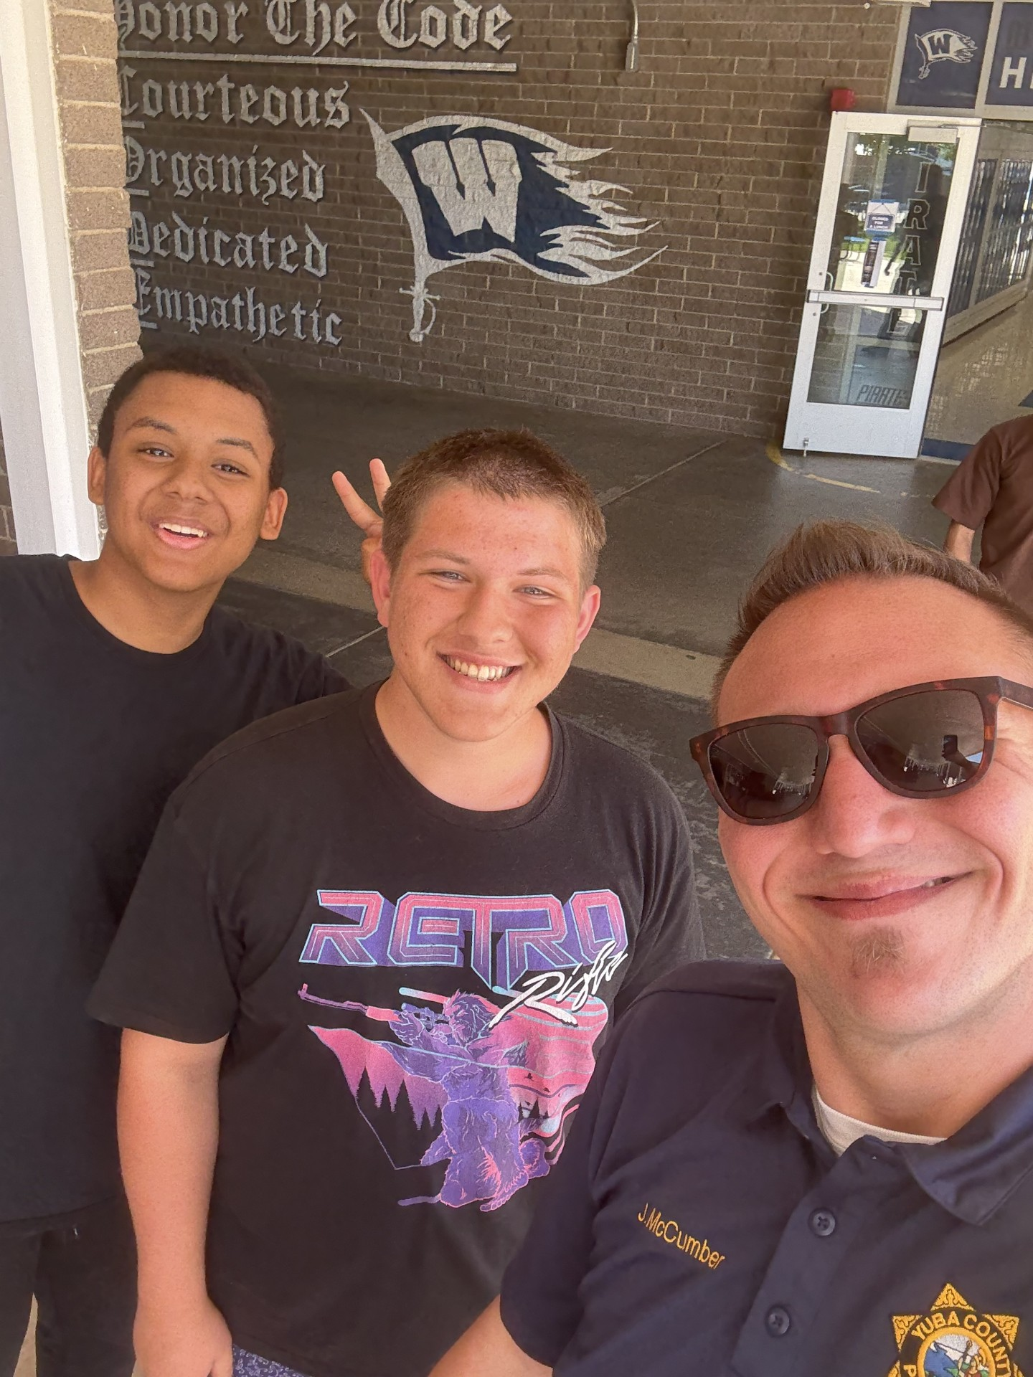
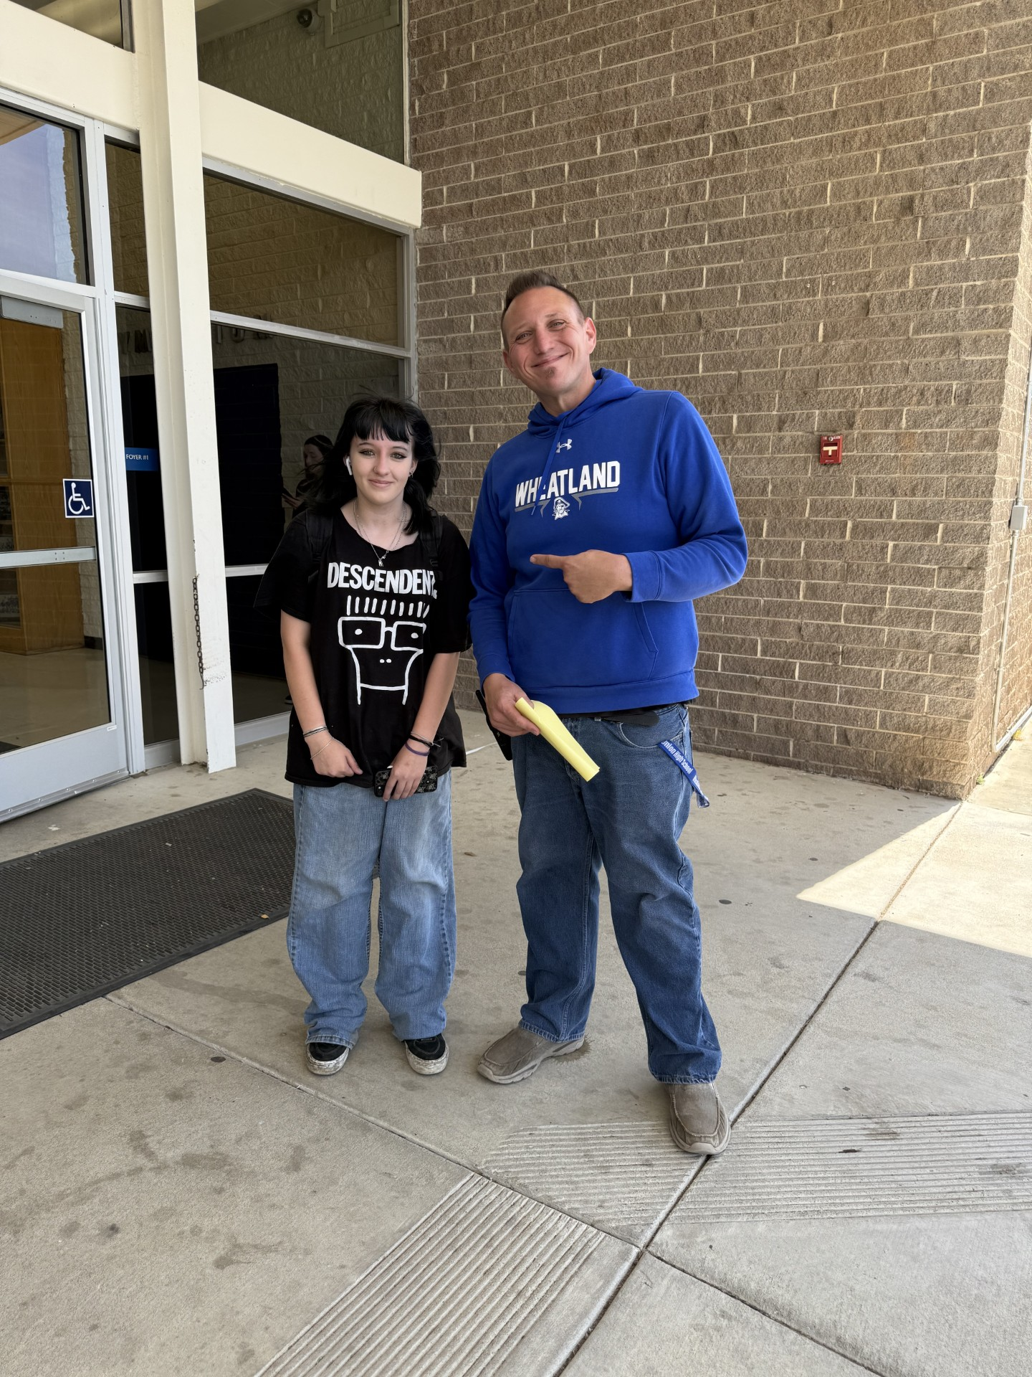
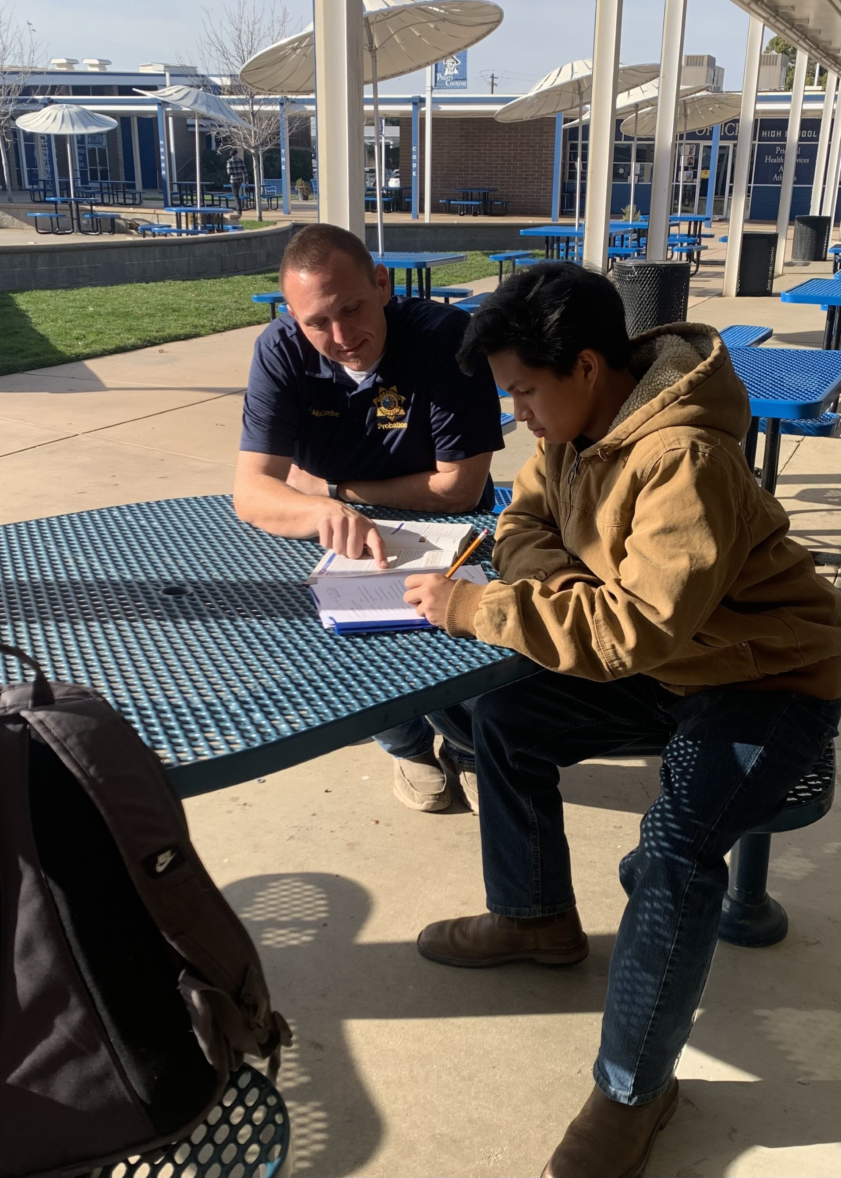
Helping Students

Slide 49
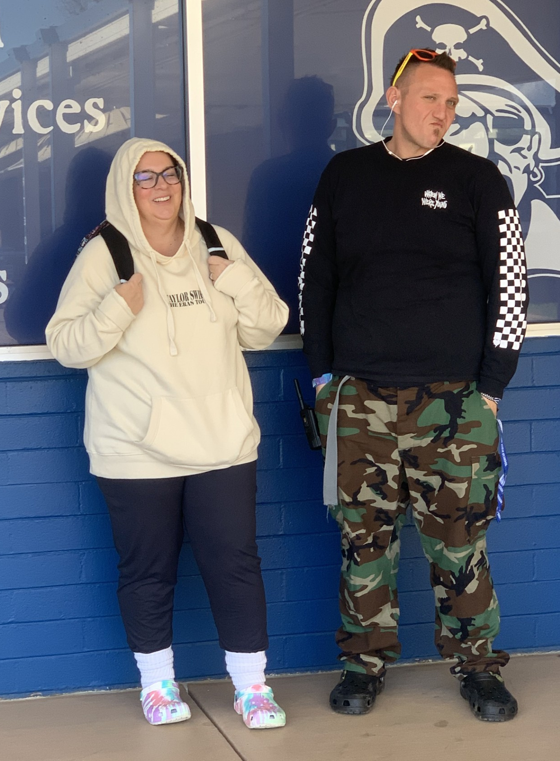
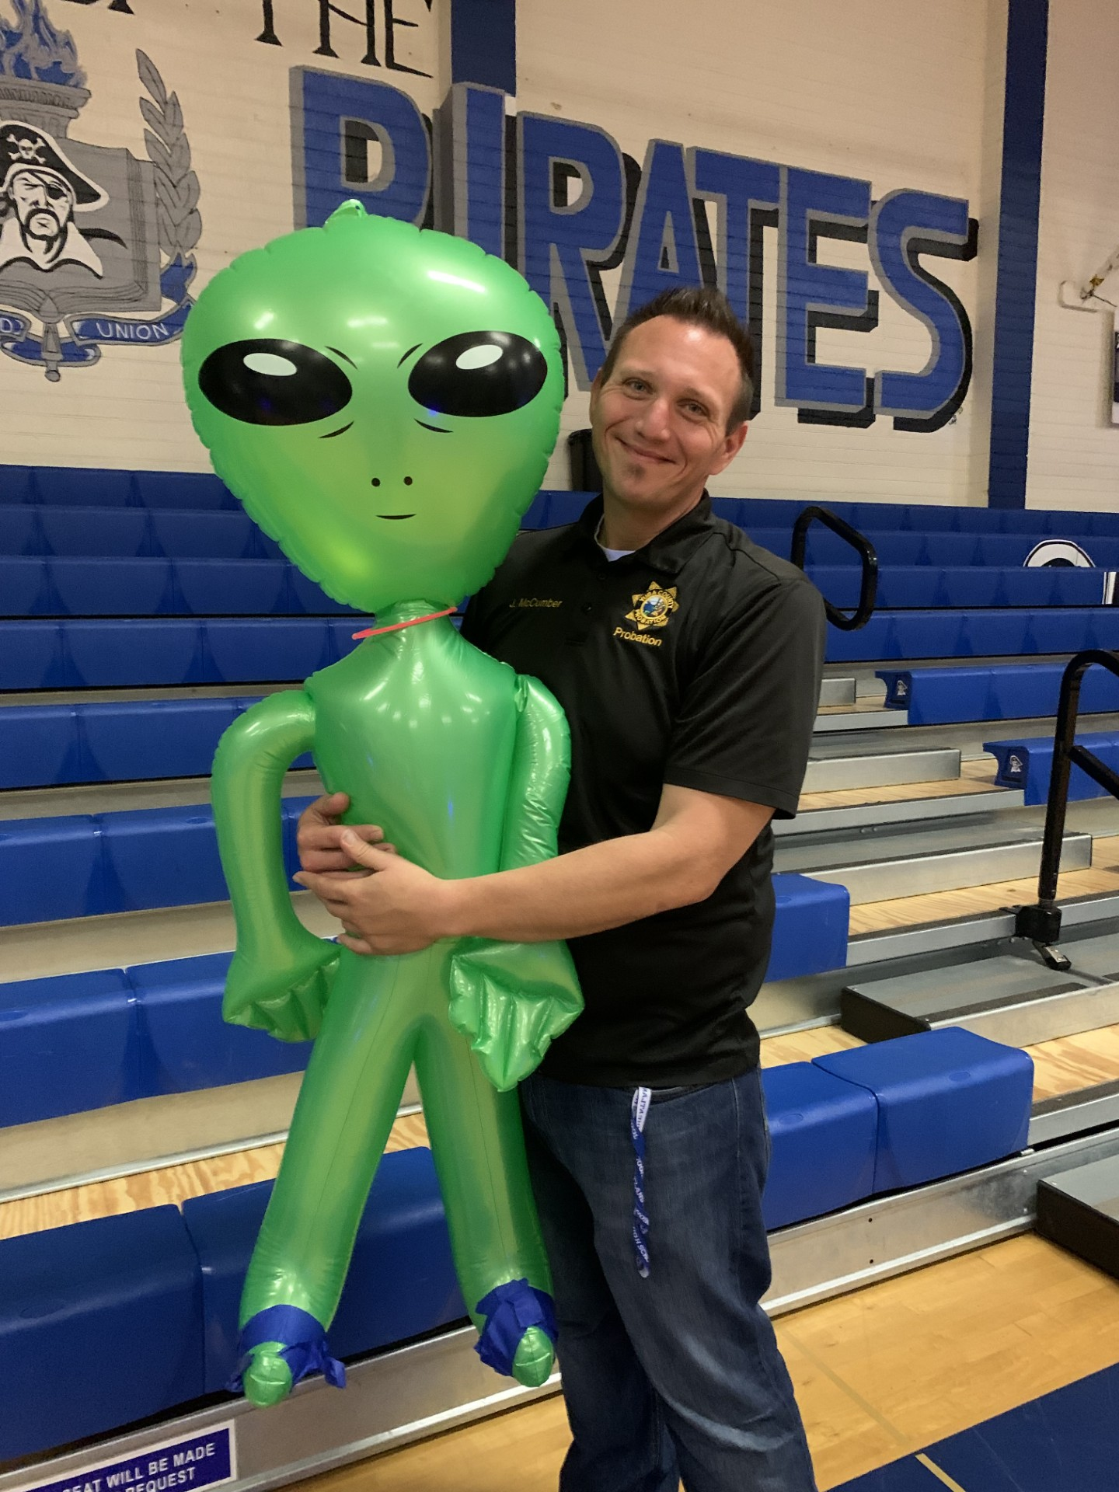
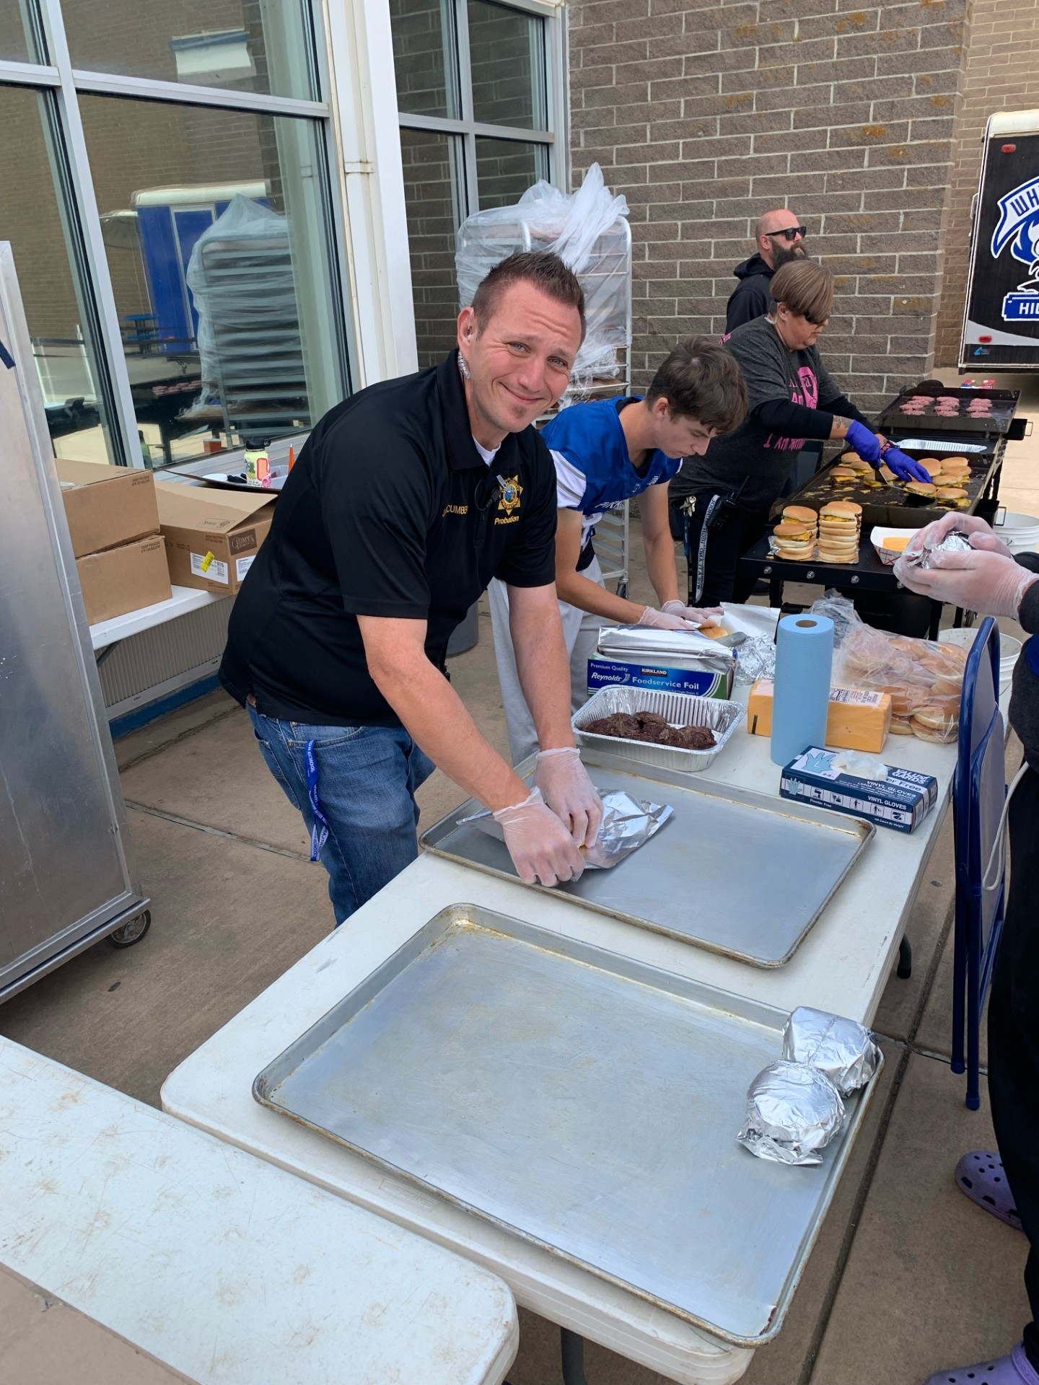
Being Part of the Change
Having fun at the Rally!
Making Smashburgers for P.B.I.S. Day
P.A.S.S. Officer and Vice Principal Wendy Simpson on “Dress like a student” day.

Slide 50
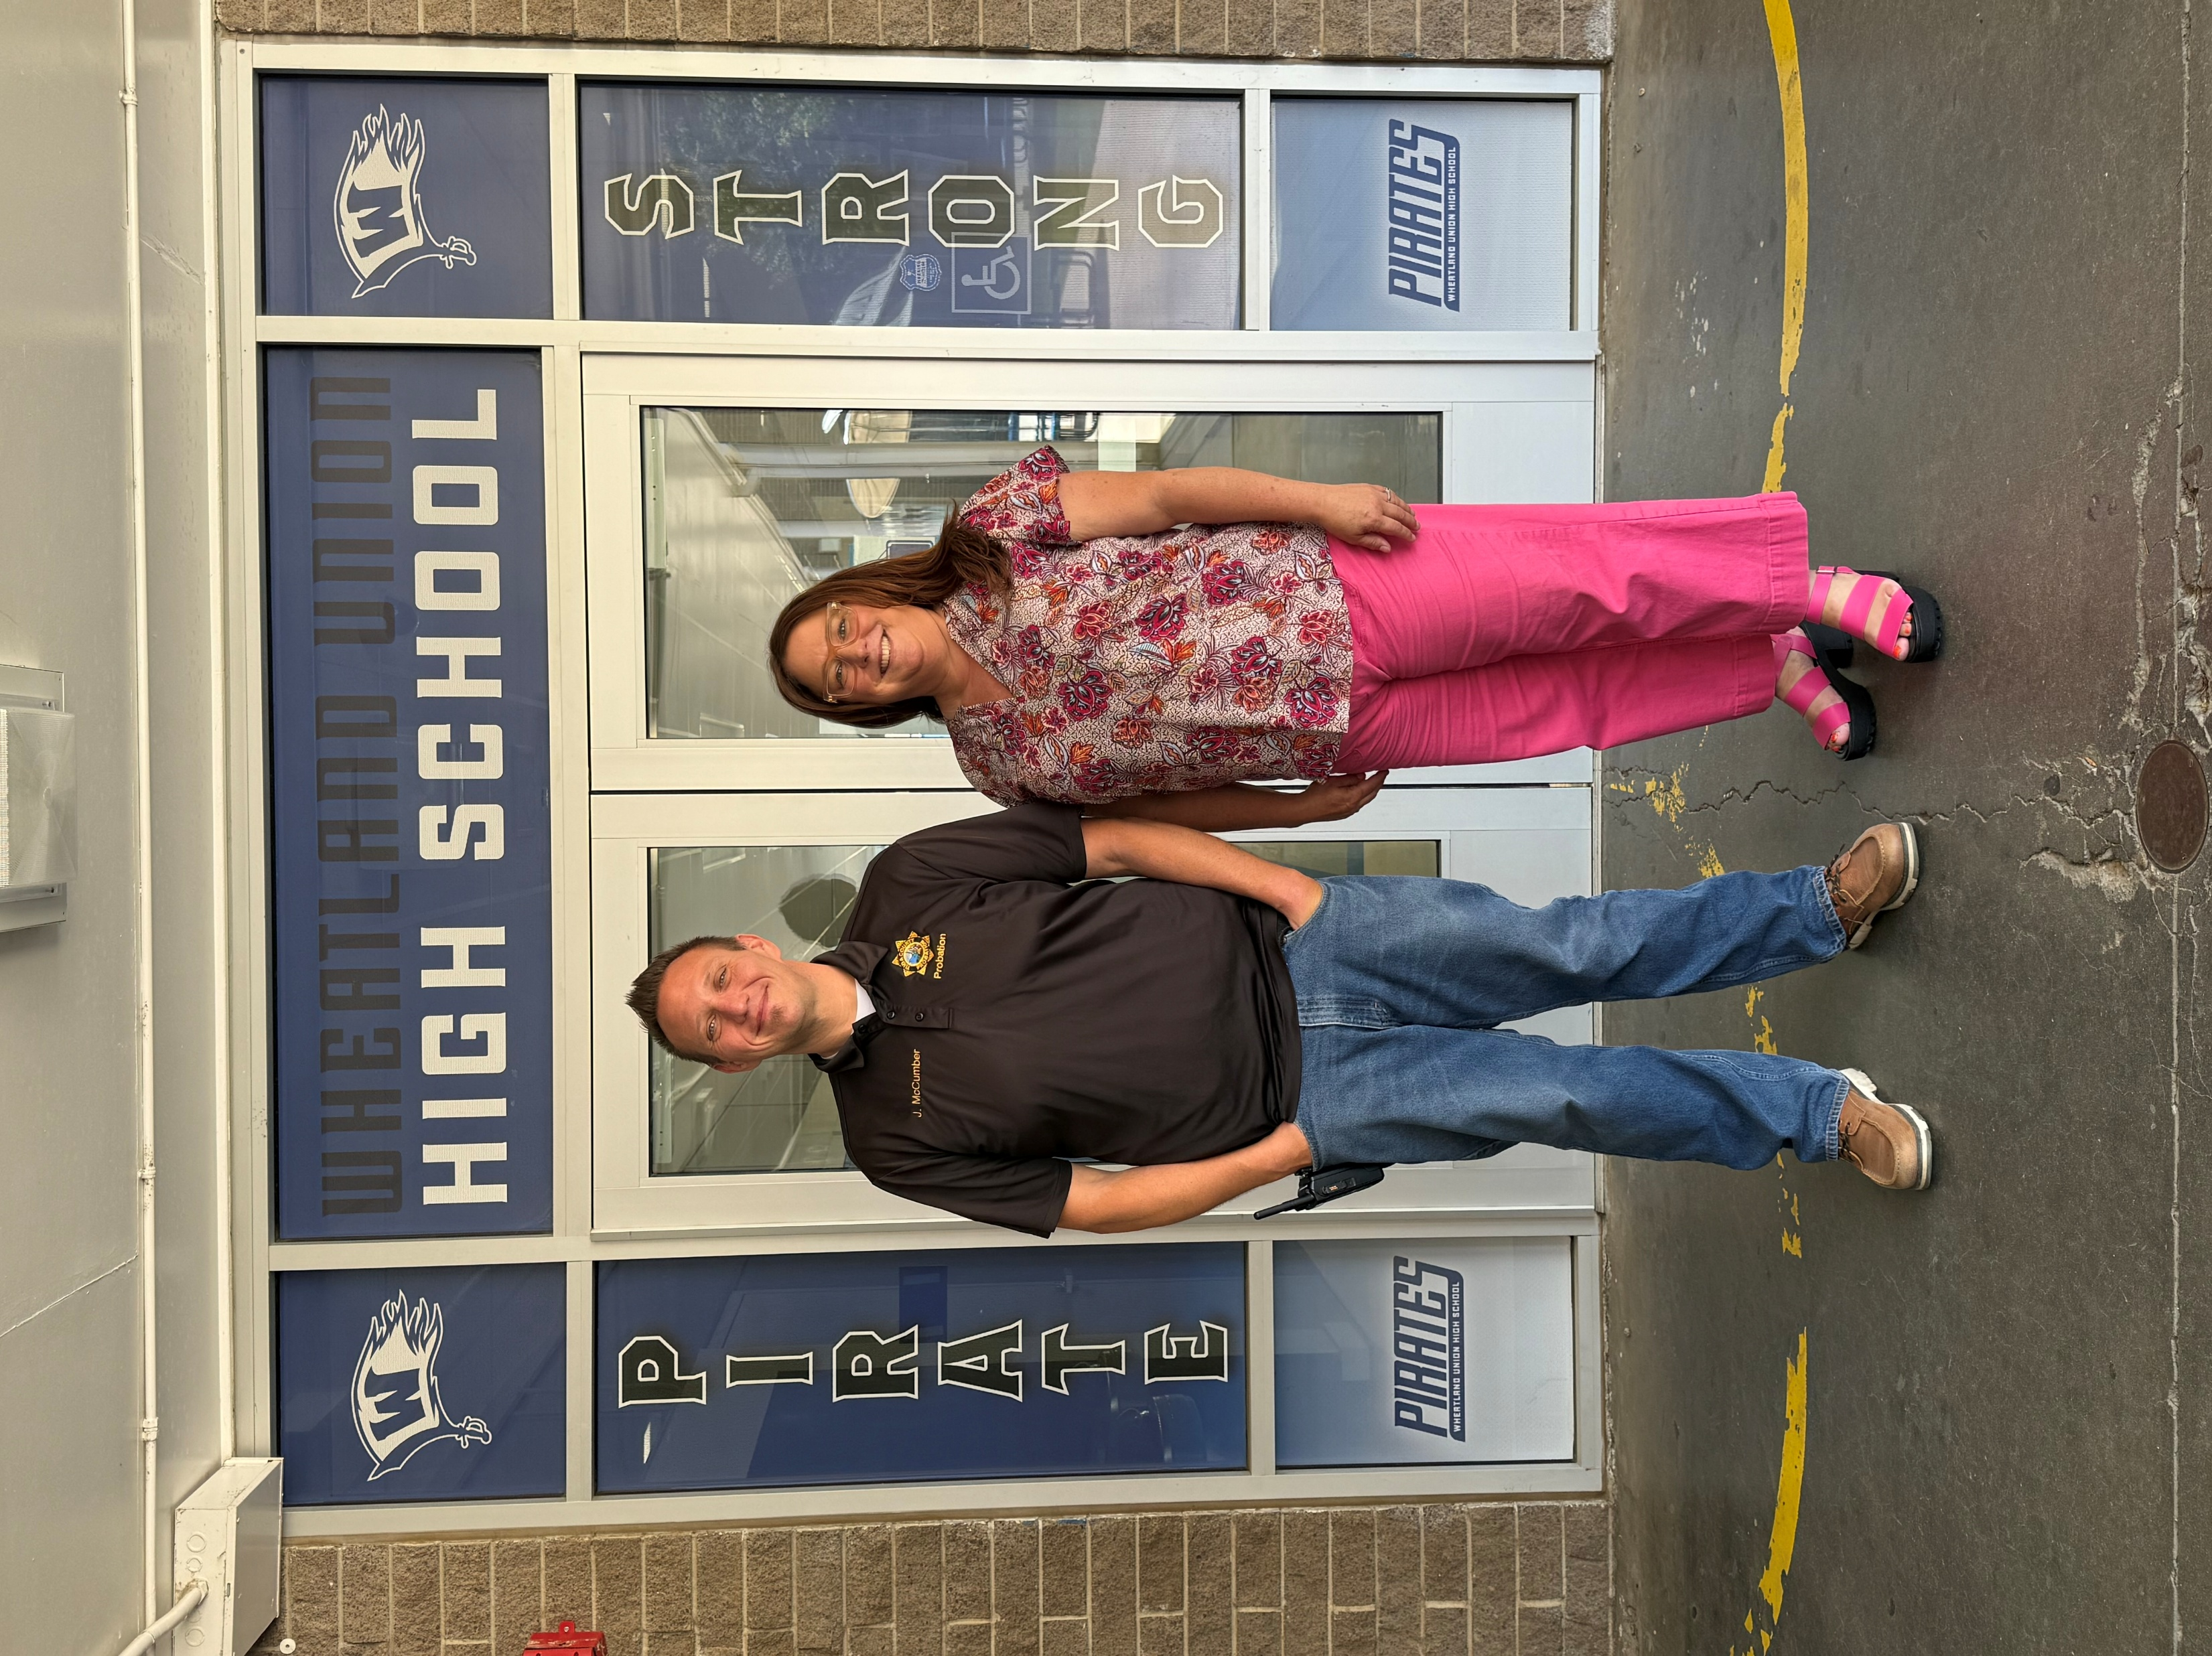

Appreciation
I have been associated with PASS Officer Jarred McCumber since 2023, when we first served together on the PBIS Tier 1 Team. From the beginning, I’ve known Jarred to be deeply empathetic to the needs of his students. This past school year, I’ve had the opportunity to work more closely with him after transitioning from teacher to Assistant Principal. In this new capacity, I’ve been consistently impressed by the way Jarred interacts with students—his presence is both meaningful and impactful, and I’ve learned a great deal from collaborating with him.
Jarred’s interactions with students are always respectful and varied. He engages with students informally throughout the day—checking in, offering fist bumps, sharing a smile, or giving a quick word of encouragement. He’s also the first to volunteer for fun and community-building activities, whether it’s taking a pie to the face, chaperoning a dance, or helping out at athletic events. His willingness to show up in these ways makes him approachable to students and staff alike. It has been both a pleasure and an honor to work alongside Jarred this year as we’ve worked to improve student safety and school culture at Wheatland Union High School. -Heather Sherk, Assistant Principal

Slide 51


Yuba County Office of Education
Enrollment
49
Established in 1990
Rob Gregor– Superintendent
Bobby Abold- Assistant Superintendent
Sherry Fortner – Principal
PASS Officer- Benny Castillo

Slide 52
Mission Statement
Our Mission is to provide students with individualized learning plans to enhance their academic, behavioral, and social emotional needs. Students discover multiple pathways for college and career readiness as they meet their personal goals.
GOALS
Improve all student's ability to learn and work in a cooperative manner with others and succeed in school.
Successfully reintegrate the students into the public school system.
Build personal responsibility and a sense of community with our student body.
Instill a sense of tolerance and empathy for others.

Slide 53
Core Values
At Thomas E. Mathews (TEM) Community School we are committed to working diligently with the other agencies who assist with the reintegration process of our students back to their home schools within Marysville Joint Unified School District (MJUSD). We strive to break down any barriers our students may have previously faced so that they may be successful going forward in their educational careers.

Slide 54

P.a.s.s. Officer Related Duties
Liaison between school, social services, parents and law enforcement.
Observation of on-campus security cameras.
Identify and refer appropriate intervention services for all students. Ex. Yuba County Office of Education, Youth for Change, Children’s System of Care, and Victim Services.
Provide intervention and prevention services to combat gang activity.
Student transport to and from school as needed to prevent transportation being a barrier of a student’s educational success.
Use progressive discipline to gain compliance of Court-ordered conditions.
Working closely with the other schools assigned probation youth attended, as equally as those attending TEM. Ex. AeroSTEM Academy Charter School, Yuba County Charter Career Preparatory, Abraham Lincoln Independent Studies, Feather River Academy, and Yuba Gardens Intermediate.

Slide 55



ATTENDANCE
Year | 2020-21 | 2021-22 | 2022-23 | 2023-24 | 2024-25
Beginning Enrollment | 35 | 36 | 15 | 19 | 18
Year-end Enrollment | 53 | 77 | 24 | 59 | 49
Average Enrollment | 44 | 56.5 | 29 | 18 | 42
***At the end of the 2024-2025 school year there were a total of 20 students successfully approved by MJUSD School Board to be reinstated back to their comprehensive school sites.
This has doubled since last year!!!!!!!

Slide 56



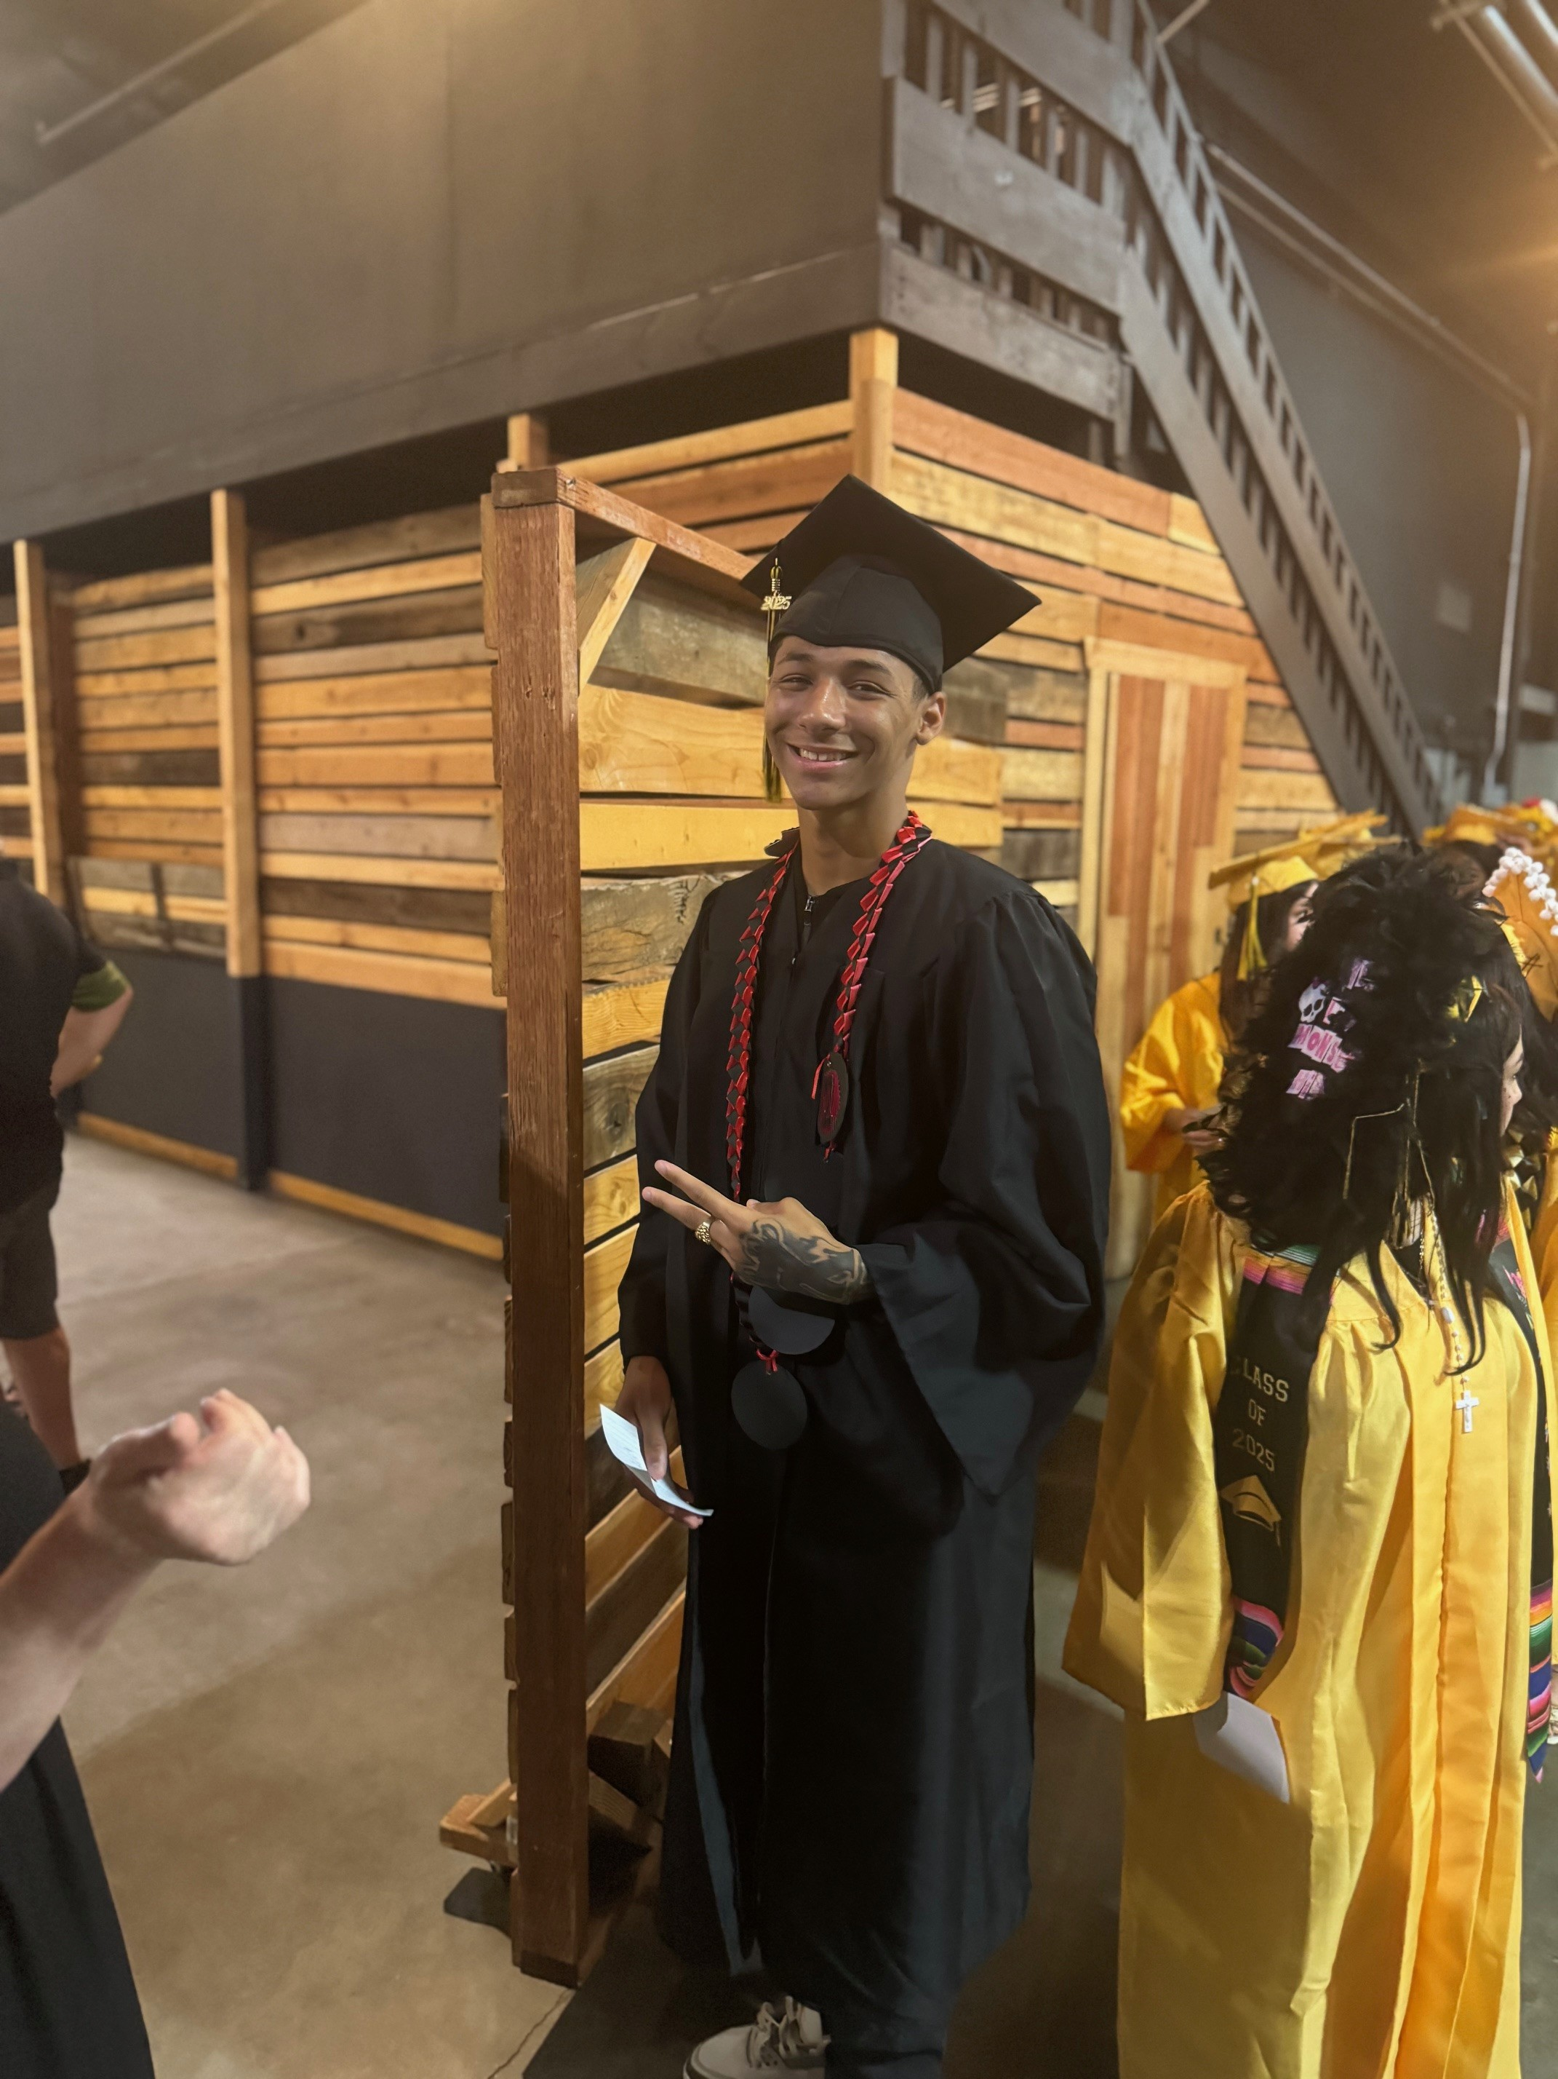


Year | 2020-2021 | 2021-2022 | 2022-2023 | 2023-2024 | 2024-2025
Promotion to 9th Grade | 2 | 9 | 5 | 5 | 18
High School Graduate | 6 | 8 | 3 | 3 | 1

Slide 57
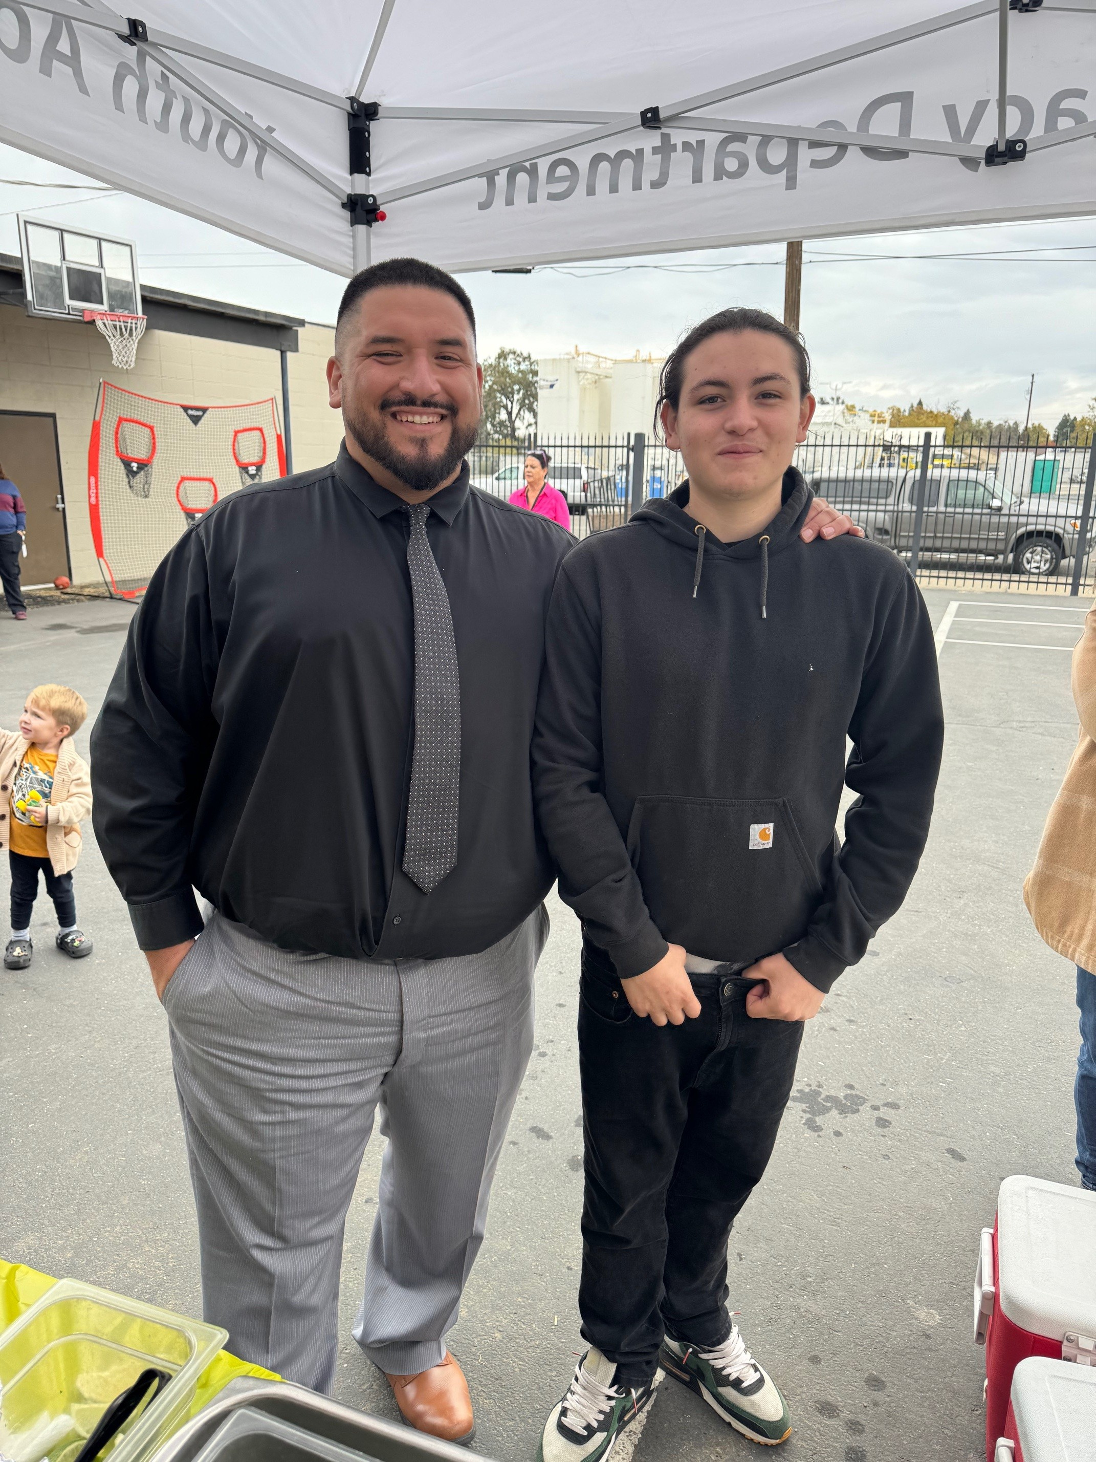


ONCE A PANTHER ALWAYS A PANTHER!!!!!

Slide 58

Corina
Attendance Clerk and Secretary

Slide 59

Benny Castillo has been the PASS officer for my first 3 years as principal for Thomas E Mathews, 2022-2025. During this time, I have witnessed the impact he makes on all students, not only those on probation. His presence has supported the entire school with our efforts to make positive changes in the lives of our students. Benny goes above and beyond in his rapport building with both students and staff. Some of our most hard to reach parents and kids feel comfortable sharing their struggles with Benny and asking for support. His perfect combination of strengths and compassion is what makes this possible. He is consistently setting expectations and following through with consequences and rewards for our kids. During the past five years, I have seen an improvement in our school culture. Fights have become a rare occurrence; attendance has improved, and family engagement has increased every year. Students who have moved back to their district schools come back to see him and share their success stories. Personally, I have come to rely on Benny’s support in many difficult situations with students and parents. He deescalates tense situations, which makes a safer and more welcoming environment for all. The benefits of PASS officers are undeniable, and Benny is one of the best.
Panther Pride
- Principal Sherry Fortner

Slide 60
APPENDIX
Welfare and Institutions Code Section 236. Article 2
Welfare and Institutions Code Section 601
P.A.S.S. Officer Trainings

Slide 61
Section 236 - Article 2: Notwithstanding any other provision of law, probation departments may engage in activities designed to prevent juvenile delinquency. These activities include rendering direct and indirect services to persons in the community. Probation departments shall not be limited to providing services only to those persons on probation being supervised under Section 330 or 654, but may provide services to any juveniles in the community.
WELFARE AND INSTITUTIONS CODE

Slide 62
Section 601
(a) Any person under the age of 18 years who persistently or habitually refuses to obey the reasonable and proper orders or directions of his or her parents, guardian, or custodian, or who is beyond the control of that person, or who is under the age of 18 beyond the control of that person, or who is under the age of 18 years when he or she violated any ordinance of any city or county of this state establishing a curfew based solely on age is within the jurisdiction of the juvenile court which may adjudge the minor to be a ward of the court.
(b) If a minor has four or more truancies within one school year as defined in Section 48260 of the Education Code or a school attendance review board or probation officer determines that the available public and private services are insufficient or inappropriate to correct the habitual truancy of the minor, or to correct the minor's persistent or habitual refusal to obey the reasonable and proper orders or directions of school authorities, or if the minor fails to respond to directives of a school attendance review board or probation officer or to services provided, the minor is then within the jurisdiction of the juvenile court which may adjudge the minor to be a ward of the court. However, it is the intent of the Legislature that no minor who is adjudged a ward of the court pursuant solely to this subdivision shall be removed from the custody of the parent or guardian except during school hours.
(c) To the extent practically feasible, a minor who is adjudged a ward of the court pursuant to this section shall not be permitted to come into or remain in contact with any minor ordered to participate in a truancy program, or the equivalent thereof, pursuant to Section 602.
(d) Any peace officer or school administrator may issue a notice to appear to a minor who is within the jurisdiction of the juvenile court pursuant to this section.

Slide 63
YUBA COUNTY PROBATION DEPARTMENT
JUVENILE COURT JURISDICTION
The Yuba County Probation Department is dedicated to early intervention, identification of at-risk youth, and implementation of preventative programs. The data reflects this concerted efforts to reduce juvenile criminal activity within our jurisdiction.
Placing P.A.S.S. Officers at the school site providing early intervention for families and students has resulted in a lower number of juveniles needing intervention by the Court and probation department.
Month & Year | July 2019 | July 2020 | July 2021 | July 2022 | July 2023 | July 2024 | July 2025
Juvenile Probation #’s | 67 | 55 | 39 | 70 | 70 | 74 | 70

Slide 64
CORE DUTIES
The primary objectives of the Probation and School Success (P.A.S.S.) Program are:
    To protect the welfare of the community and its youth by reducing the dropout and truancy rate amongst students
    Assist school administrators with the safe operation of their schools
    Reduce disciplinary problems within the school
    Enhance the individual potential of students to be successful
    Additional objectives include involving parents, school, and P.A.S.S. officers in a collaborative effort of support for educational achievement by youth

Slide 65
Core Goals
Students involved in the P.A.S.S. Program will be closely monitored once entering a school. This will provide consistency of services offered and the ability to measure the impact the program has on its students. These students will be monitored from school to school. Transition services will be provided as needed.
Provide statistical information regarding direct officer services.
These annual reports will be distributed to the:
    Wheatland Union High School District
    Yuba County Office of Education
    Yuba County Probation Department Management
    Yuba County Board of Supervisors
    Honorable Debra L. Givens, Presiding Judge of Yuba County Superior Court

Slide 66
2024/2025 Yuba County Probation Officer Training
Heather Wolfe, JCO
Handcuffing
Weaponless defense contactless
Chemical Agents
Weaponless defense - update
MI Practice Session II
Bloodborne Pathogens Online
Blended Learning Adult First Aid/CPR/AED
Weaponless defense update
CSEC 101/102
Master Leadership- Wellness and Resiliency Training
Gracie Survival Tactics Level 1
Jarred McCumber, DPO
Weaponless Defense – Contactless
MI Practice Session II- Change/Sustain Talk
DBT First Aid
Weaponless Defense Update
Firearms- Range Introduction
Handcuffing
Foster Care Training: Family Finding & Engagement
2-day MI Training
Bloodborne Pathogens Online
Blended Learning Adult First Aid/CPR/AED
1st Responder Mental Health & Wellness Conference
Firearms- Range introduction session 2
Weapon Retention
CSEC 101/102
Weaponless Defense update
Firearms- Night Shoot
Chemical Agents
Masters Leadership
Impact Weapons Update
Benito Castillo, DPO
Foster Care Training: Family Finding & Engagement
Handcuffing
Weaponless defense contactless
Firearms: Partner Communication
Firearms: Handling and Safety
Advanced Weaponless Defense
DBT First Aid
Firearms: Cold Weather Gear/Concealment Gear
CSEC 101/102
Weapon Retention
Sac Driving School Air Brake Training
Firearms: Night Shoot
Firearms - Simulations Scenario Training
Bloodborne Pathogens Online
Blended Learning Adult First Aid/CPR/AED
TLO Basic-CCIC
Chemical Agents
Gracie Survival Tactics
MI Practice Session II
Firearms: Moving & Engaging Under Stress

